Slide 1
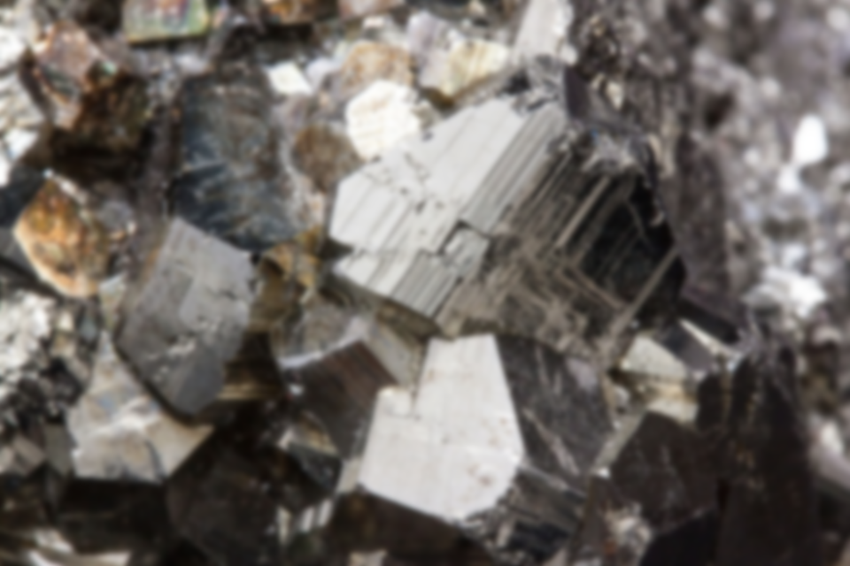
ROCKS
MINERALS

Slide 2
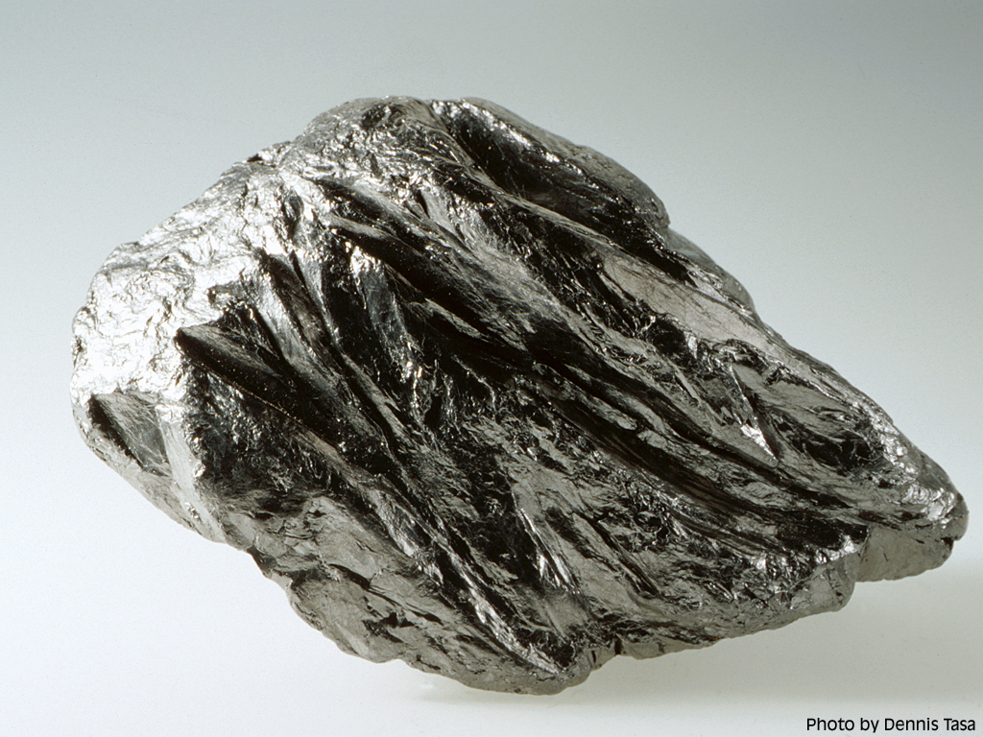
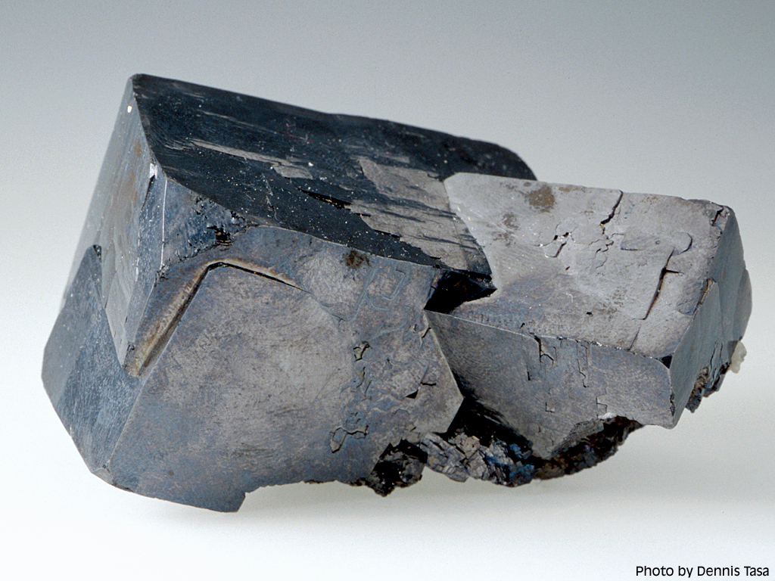
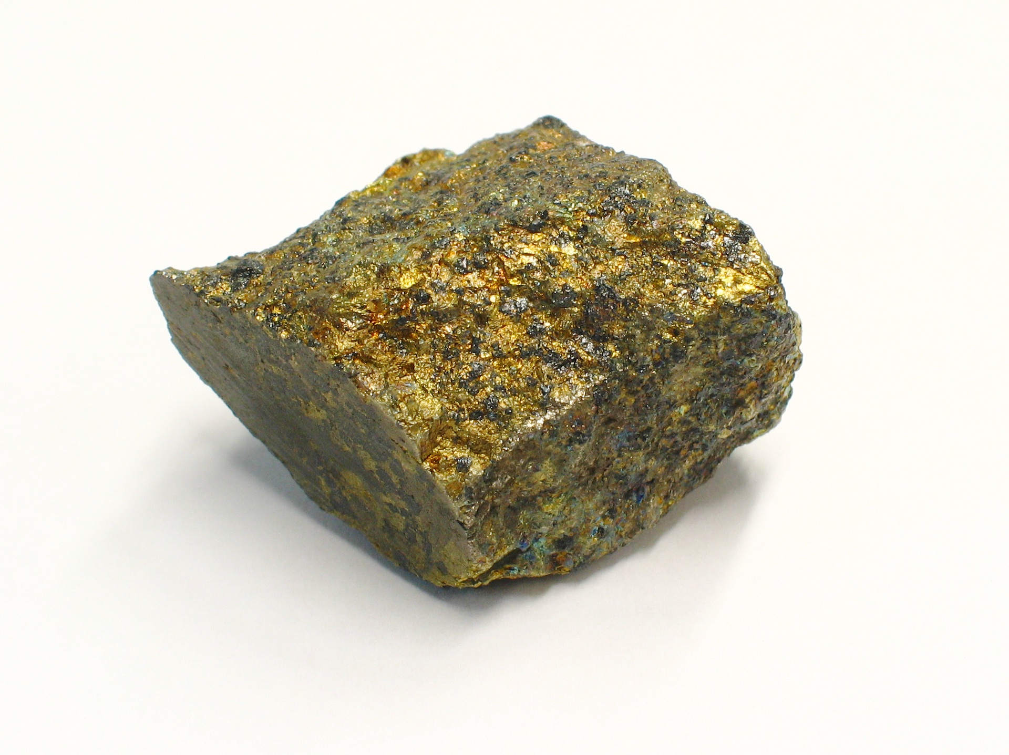
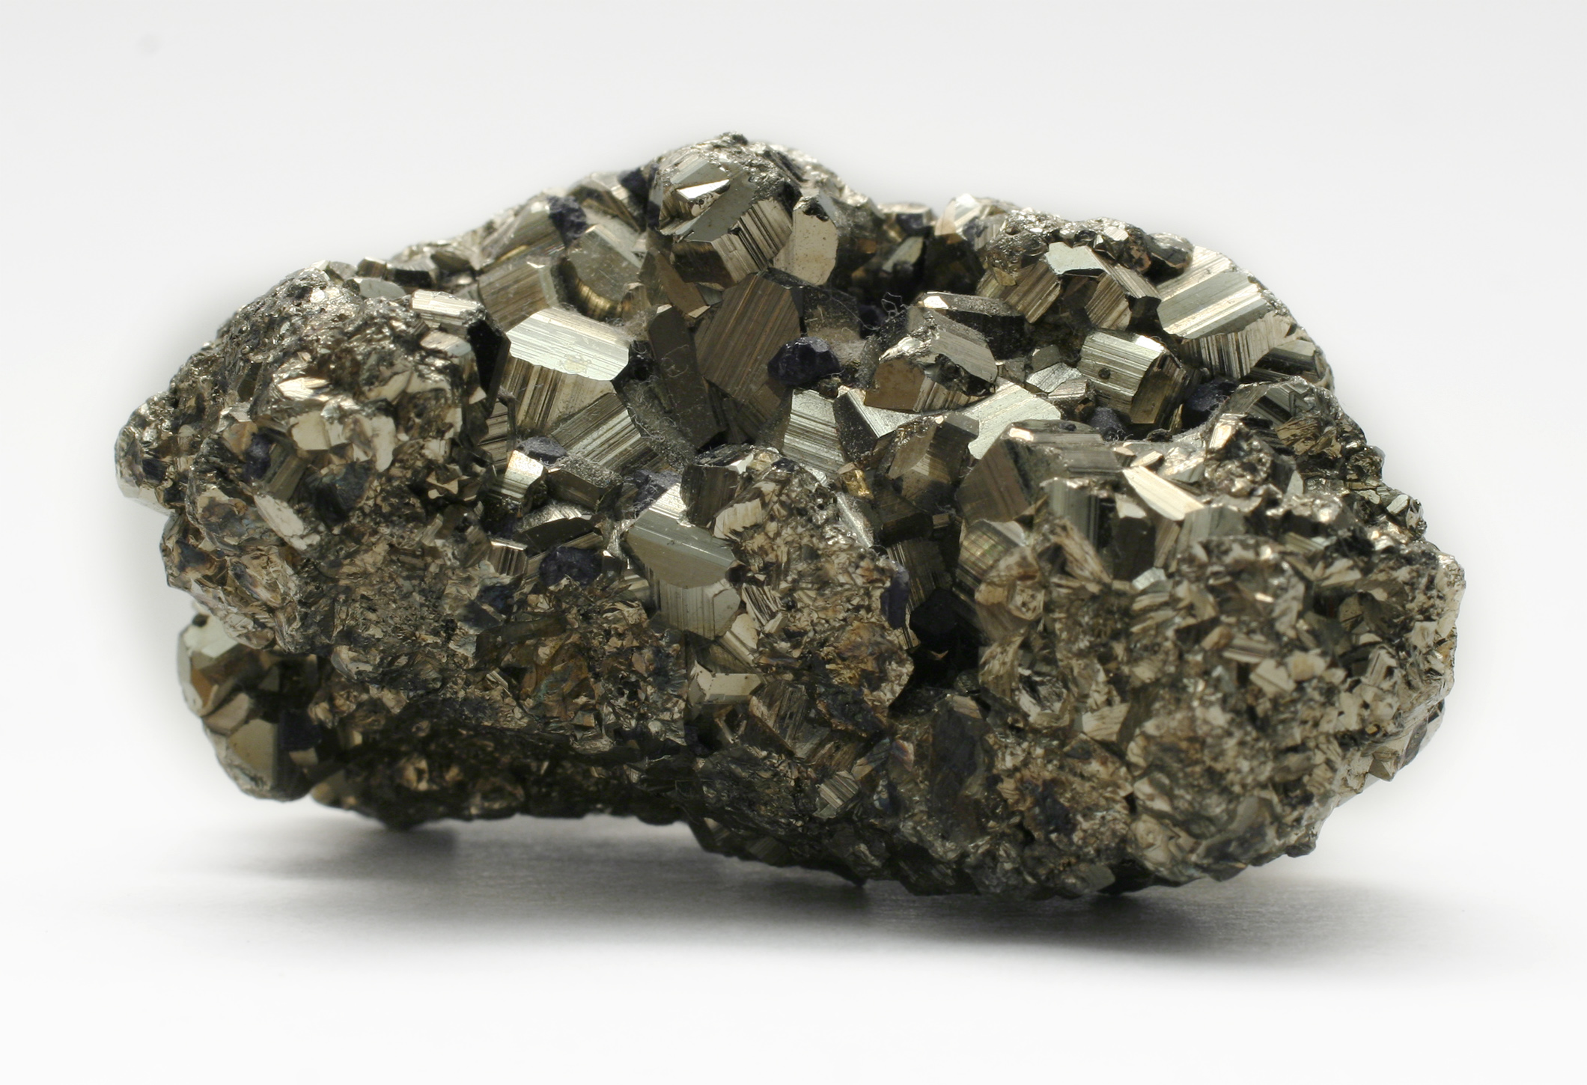
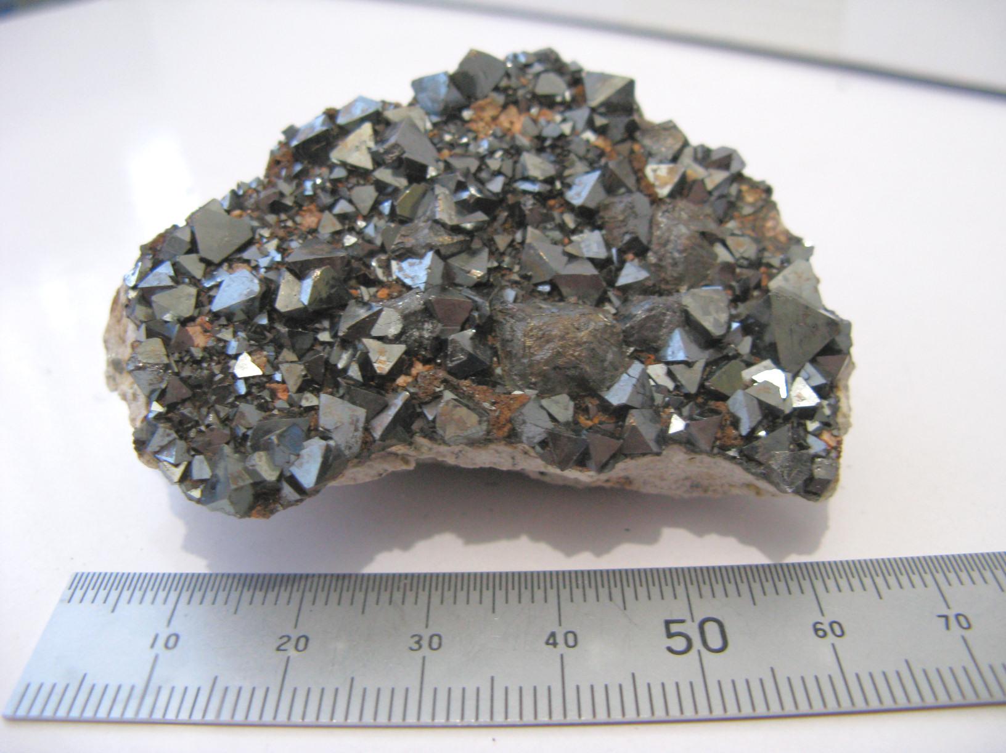
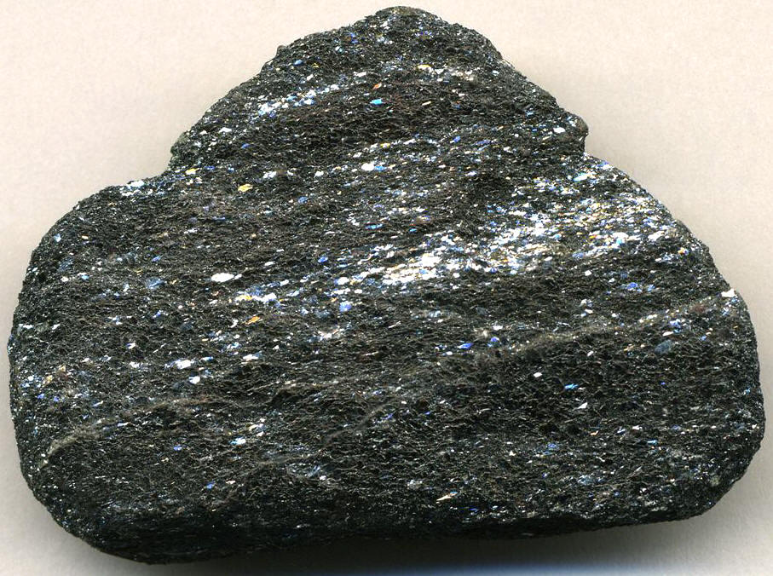
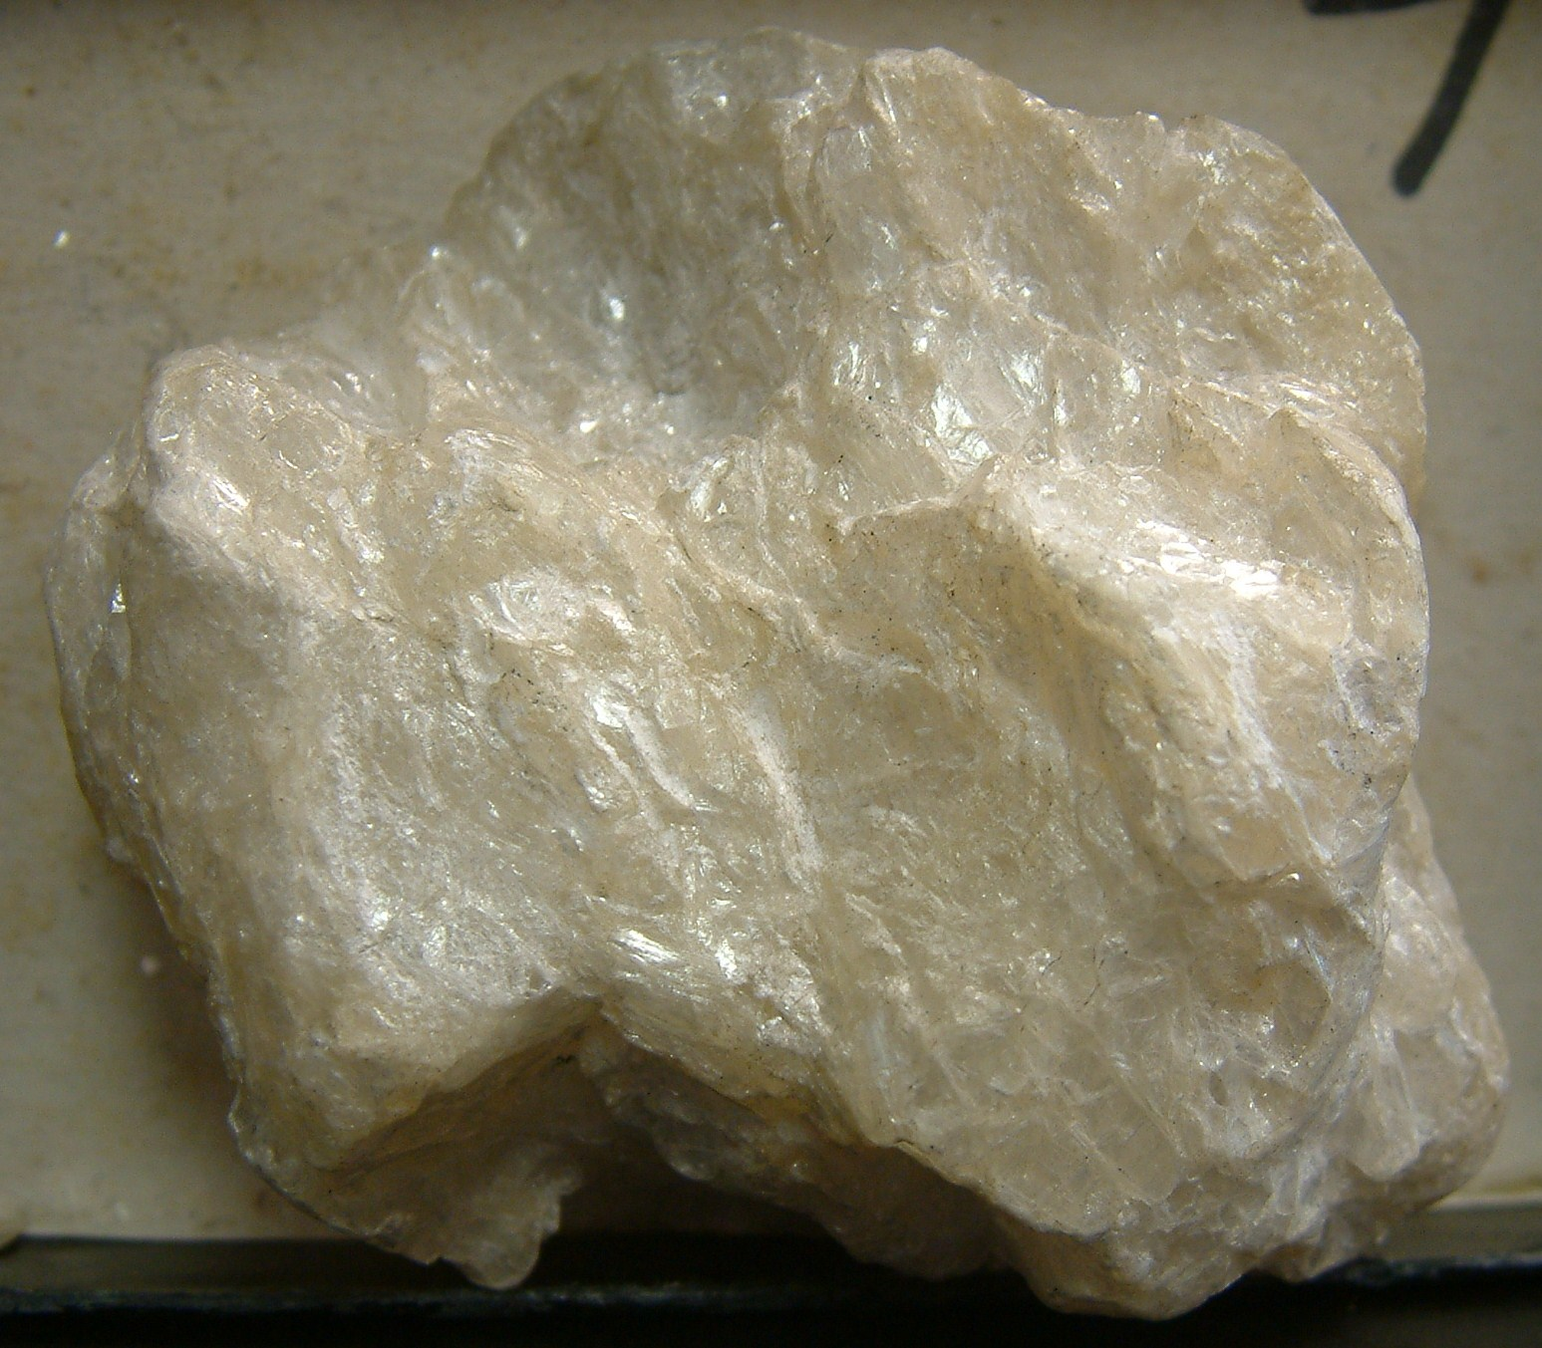
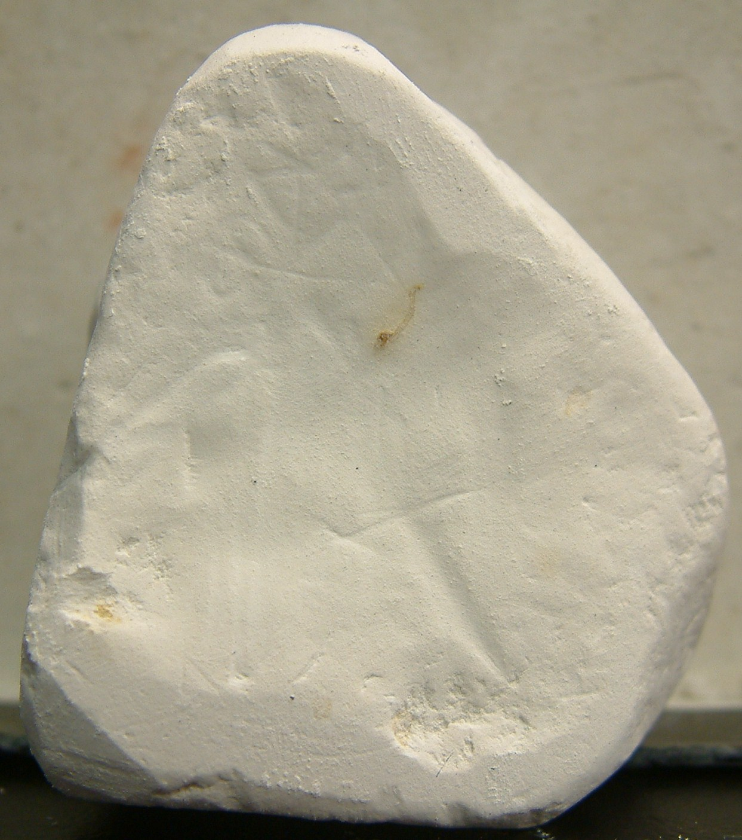
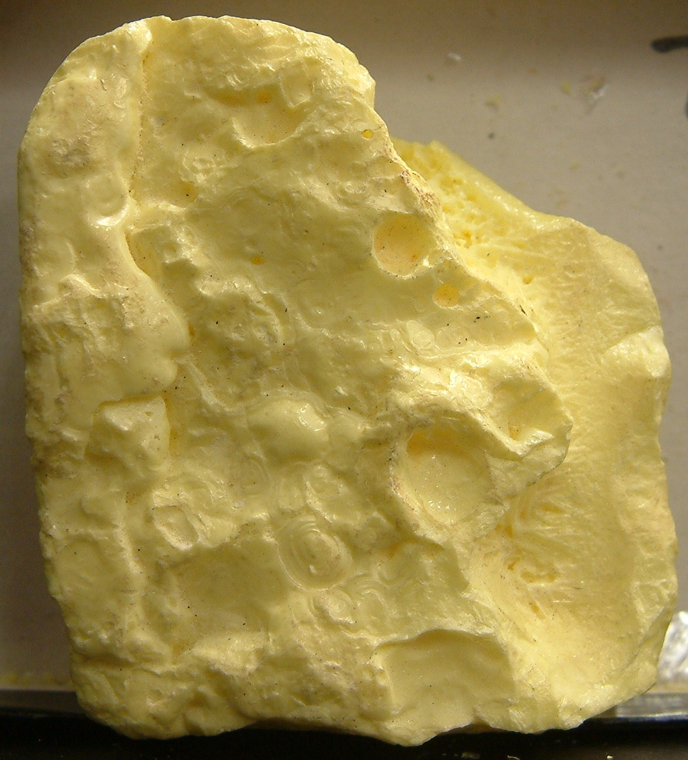
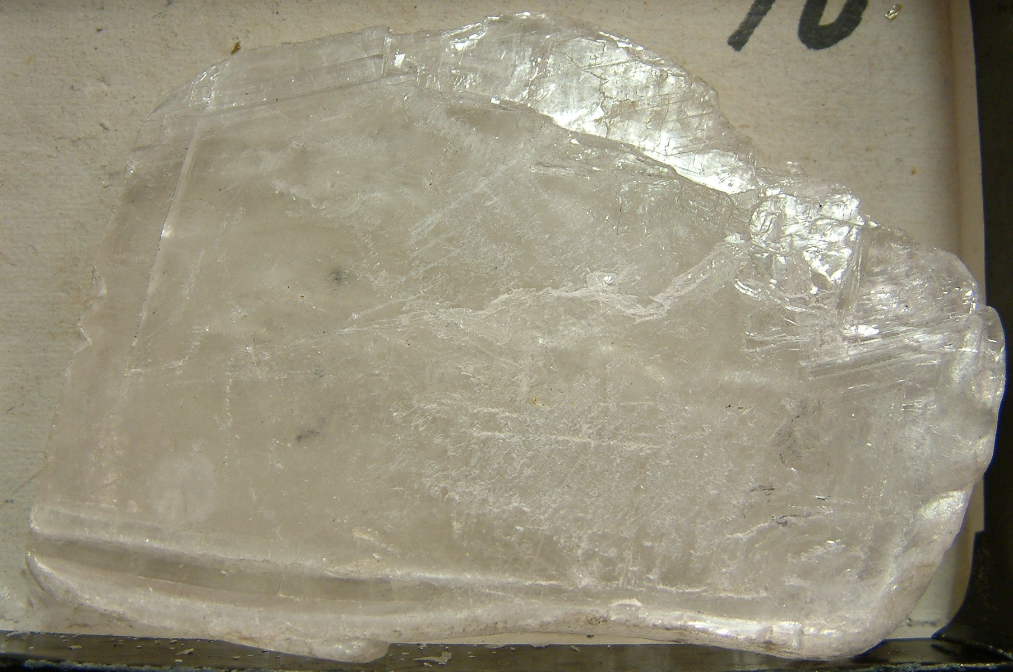
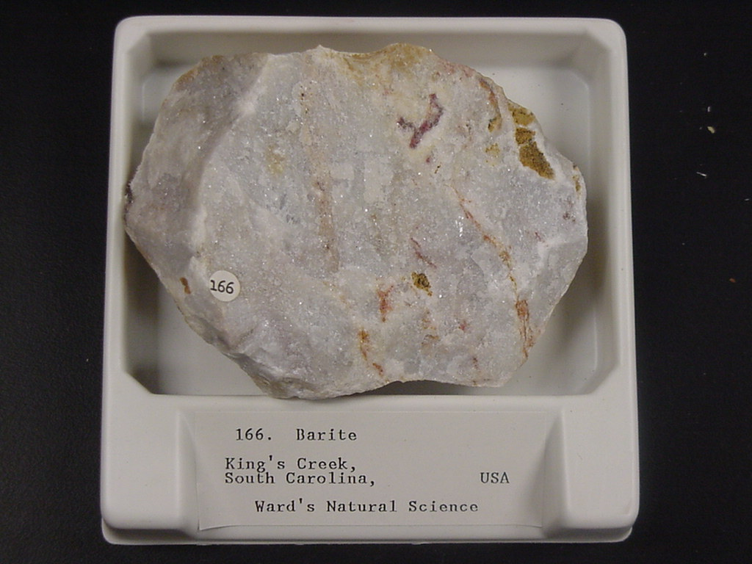
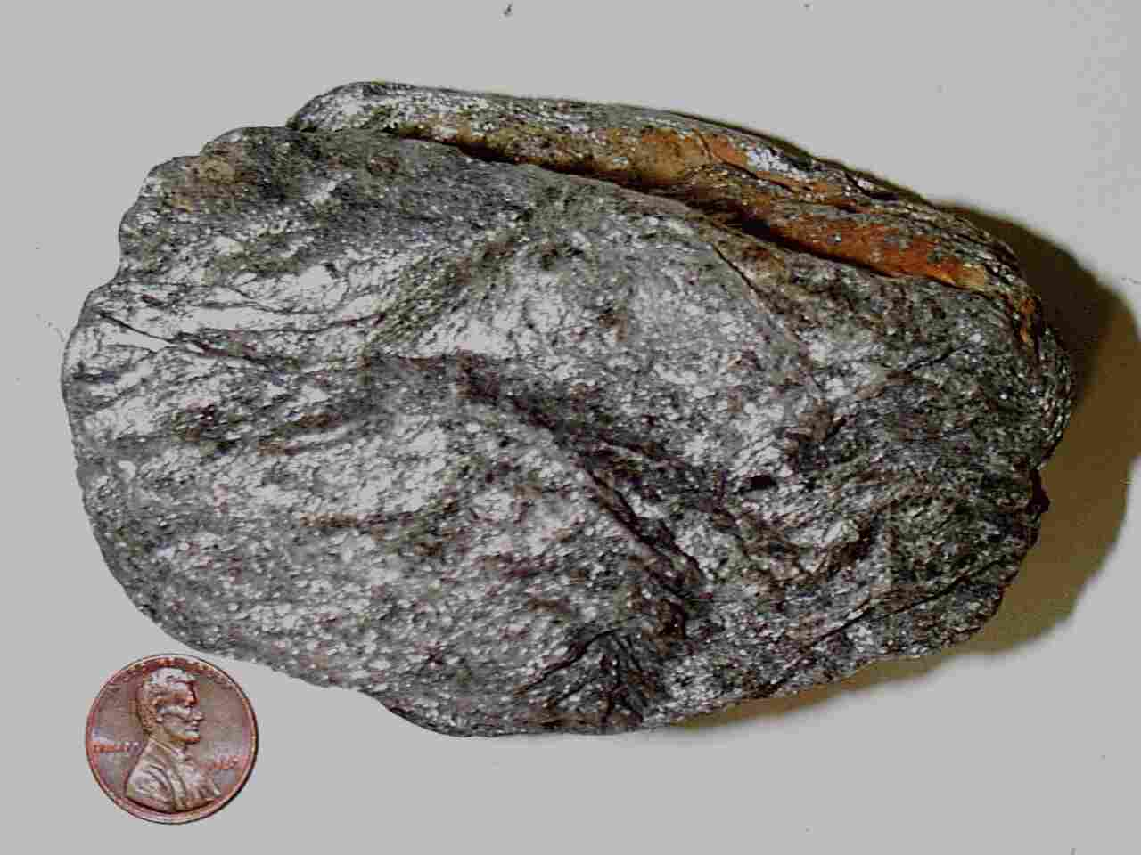
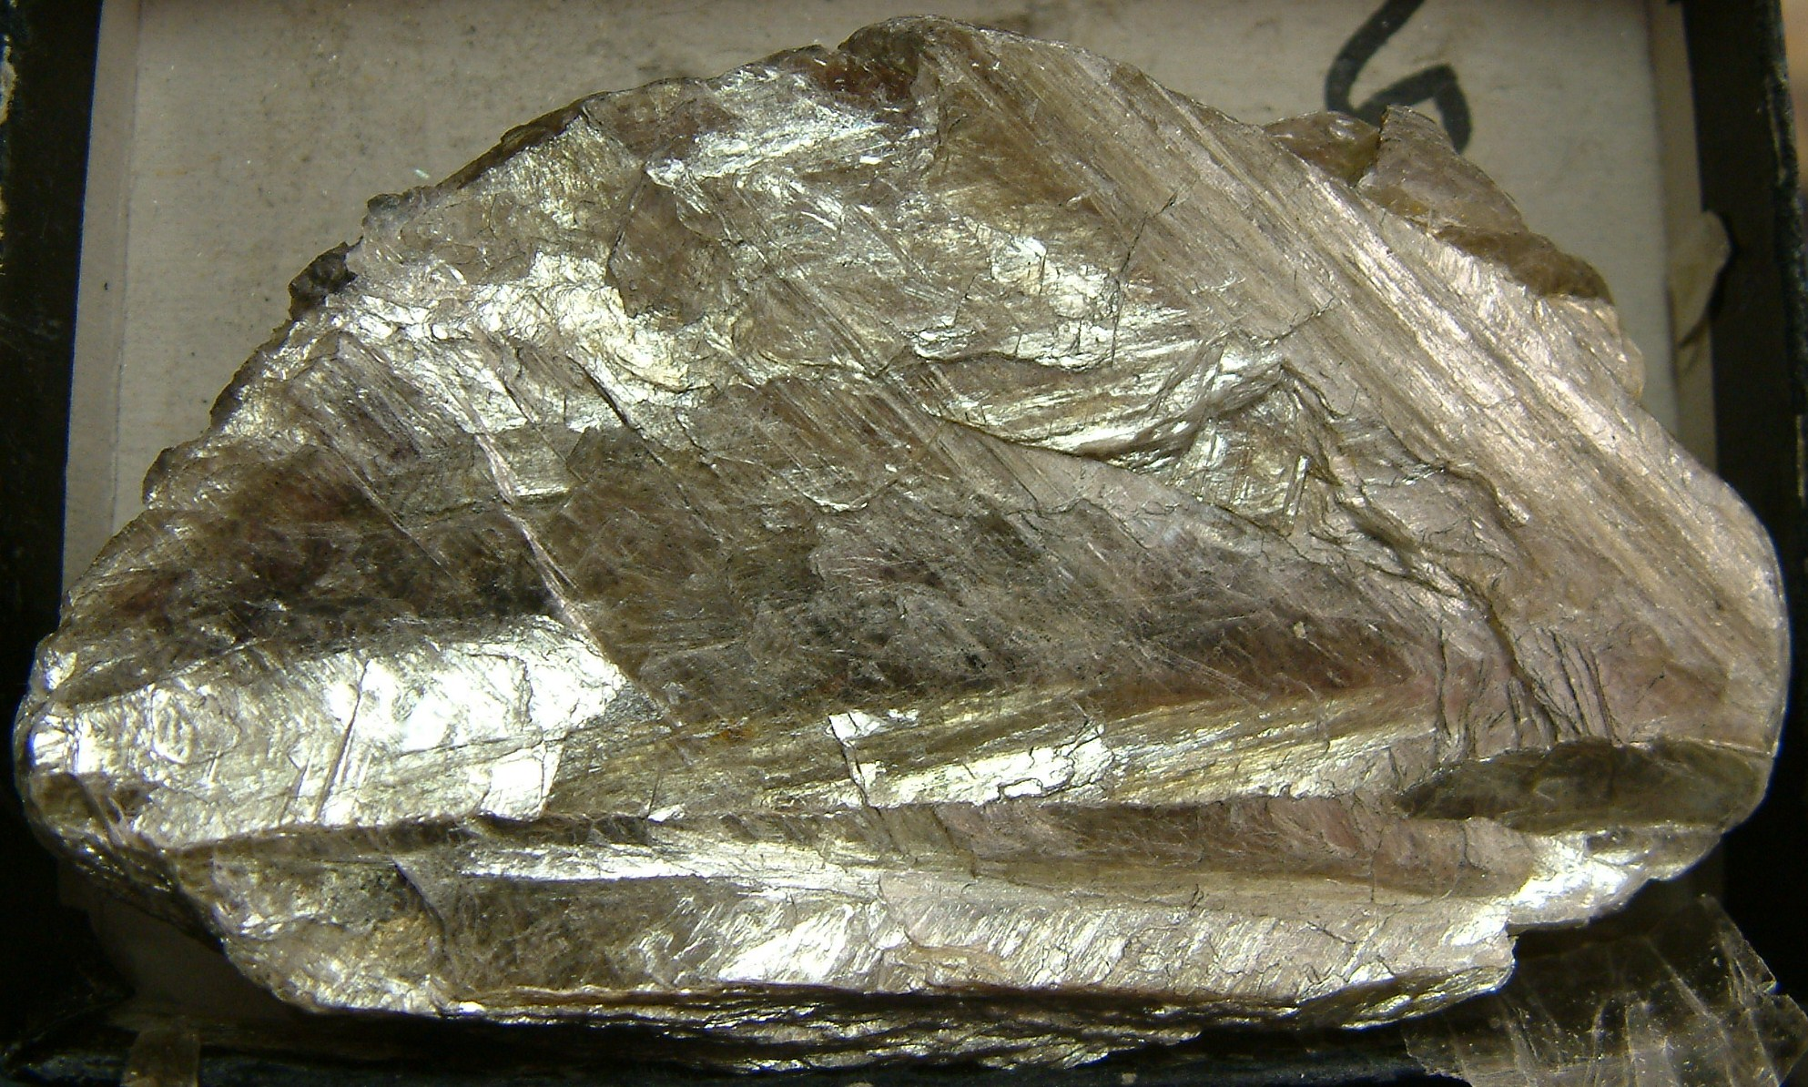
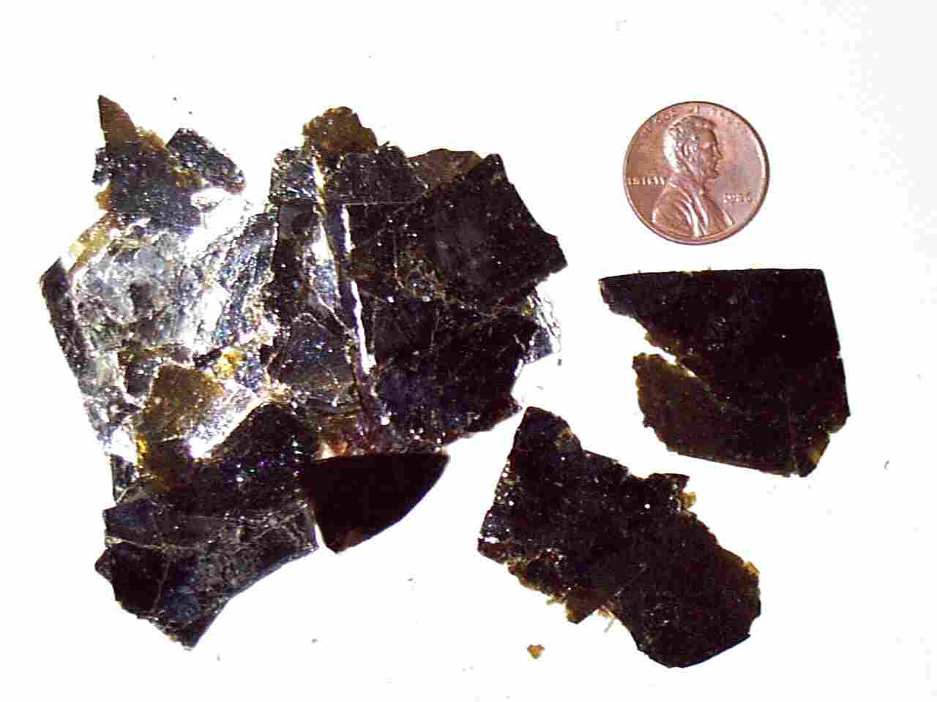
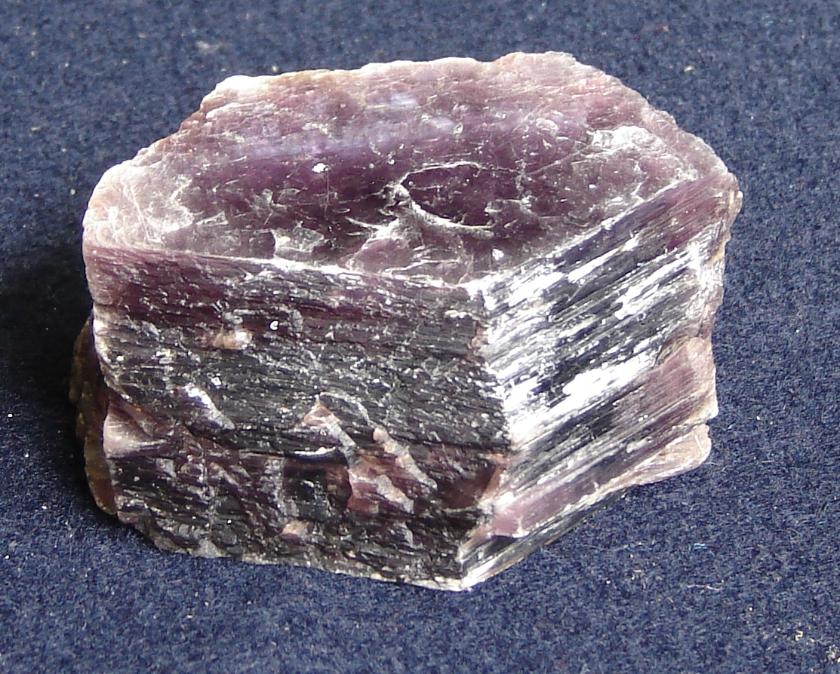
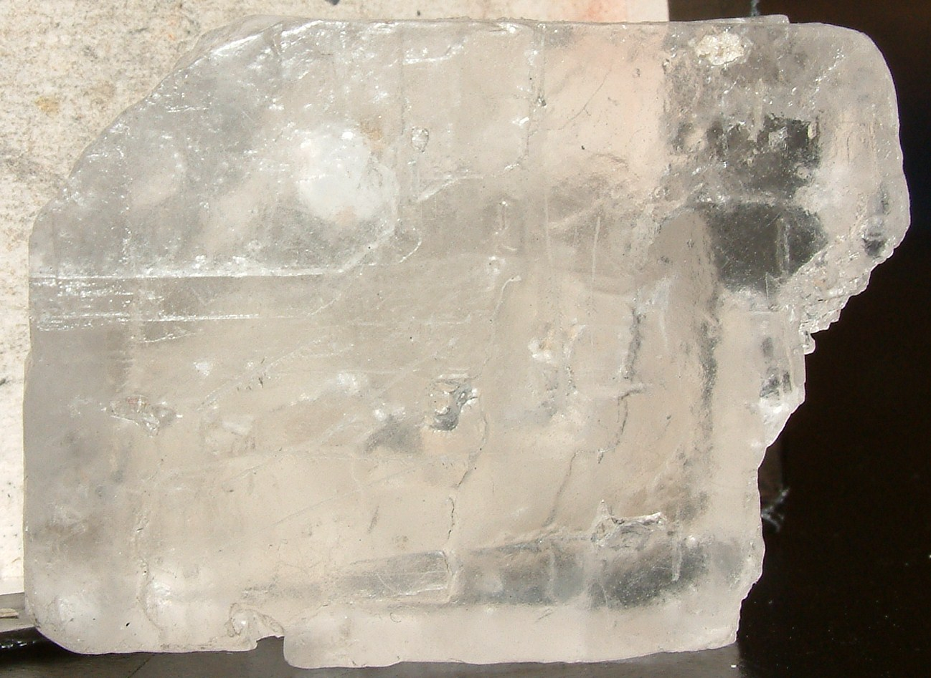
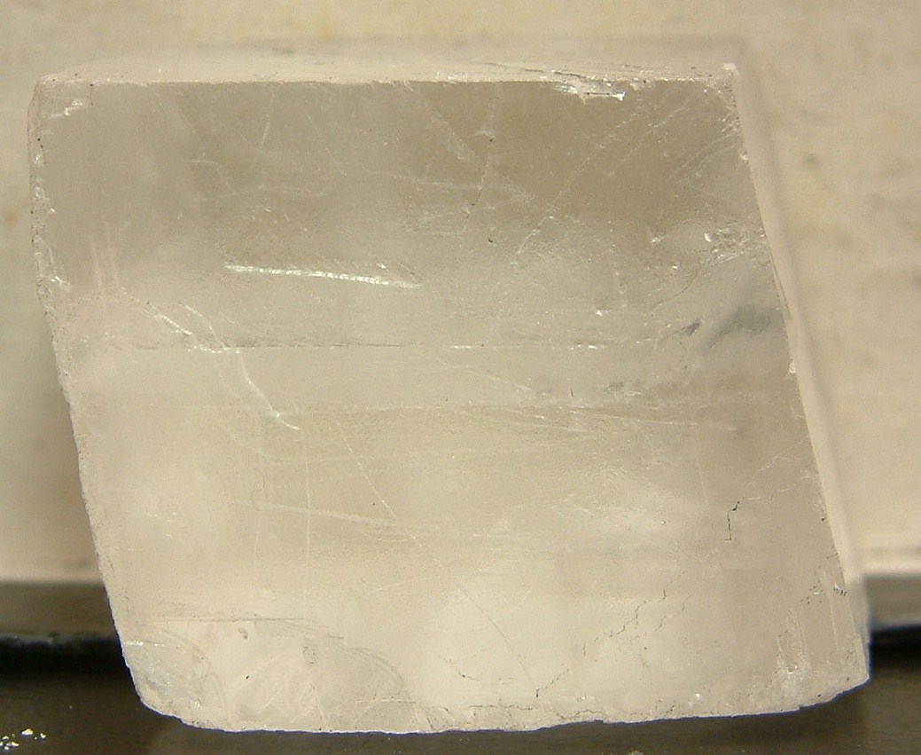
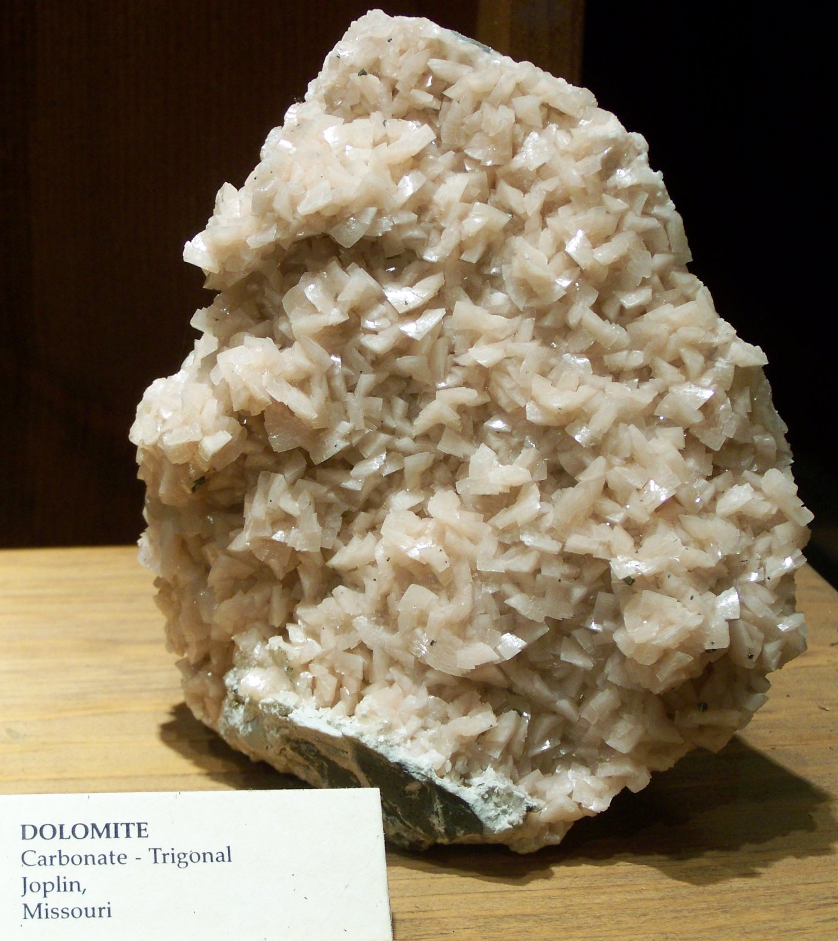
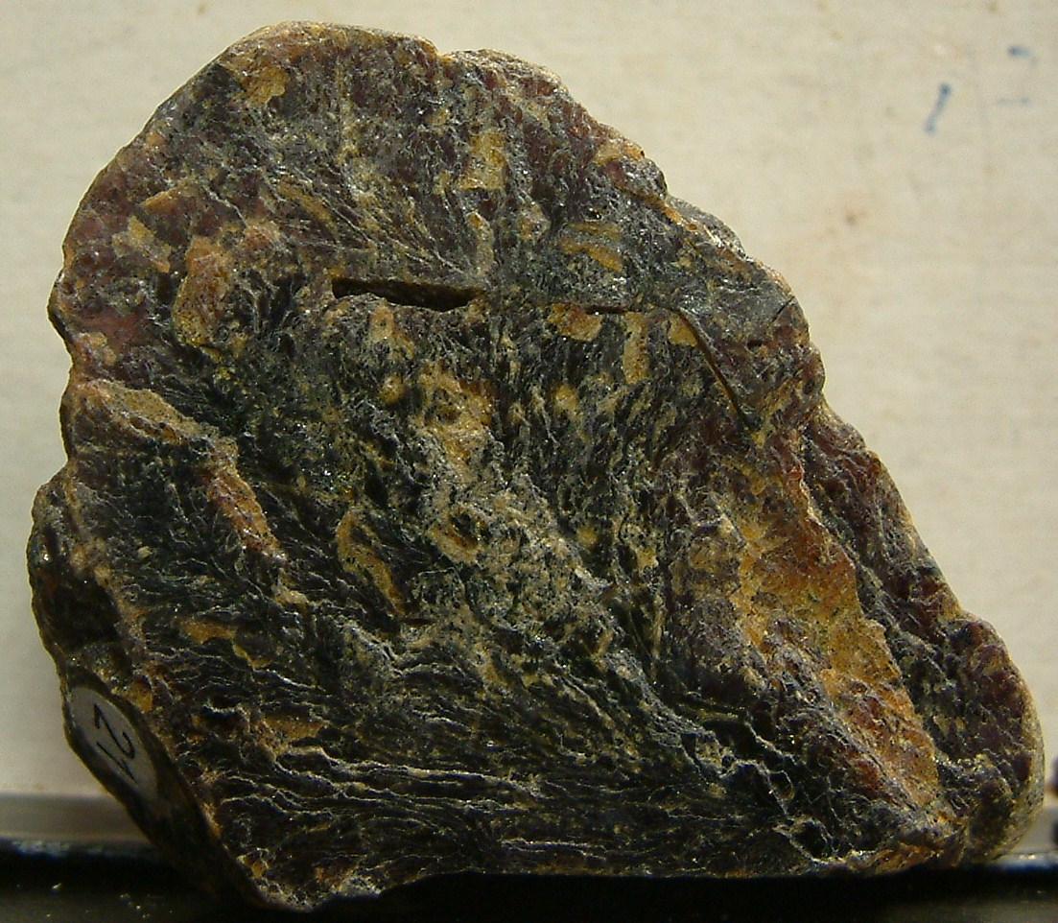
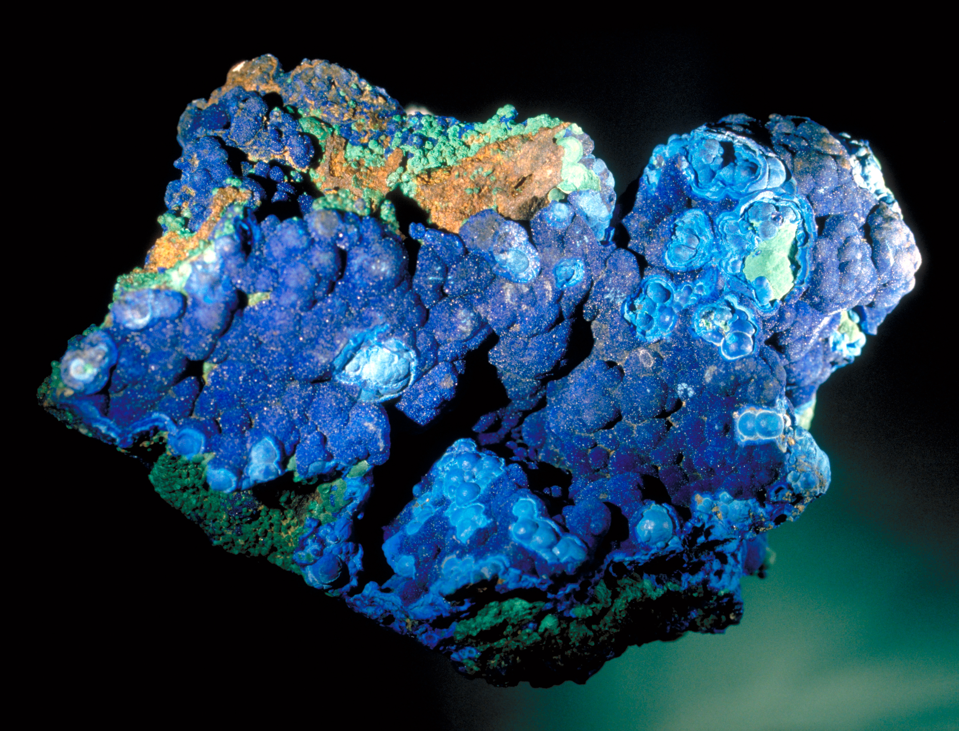
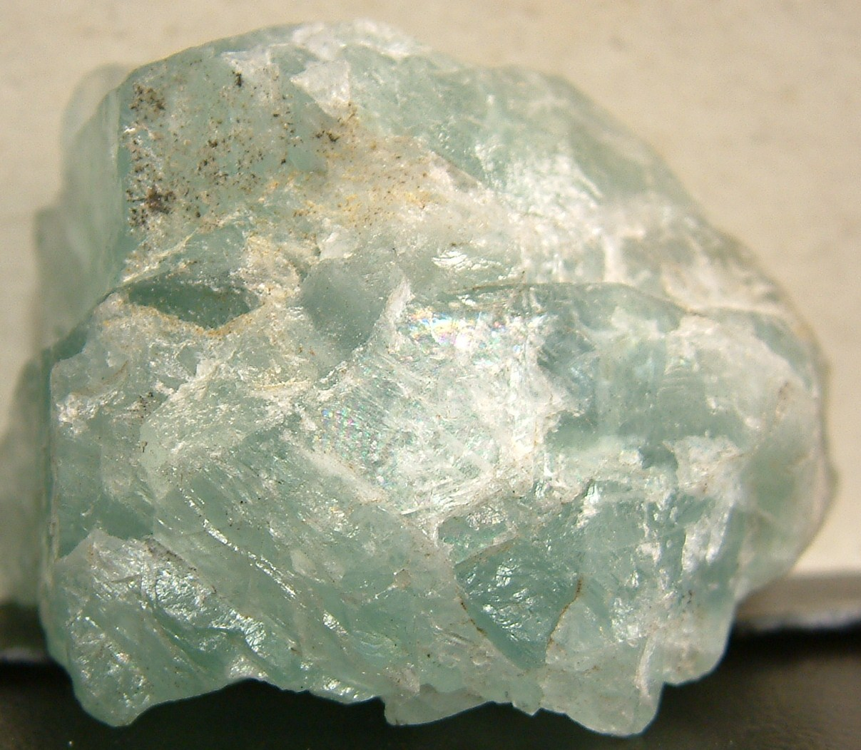
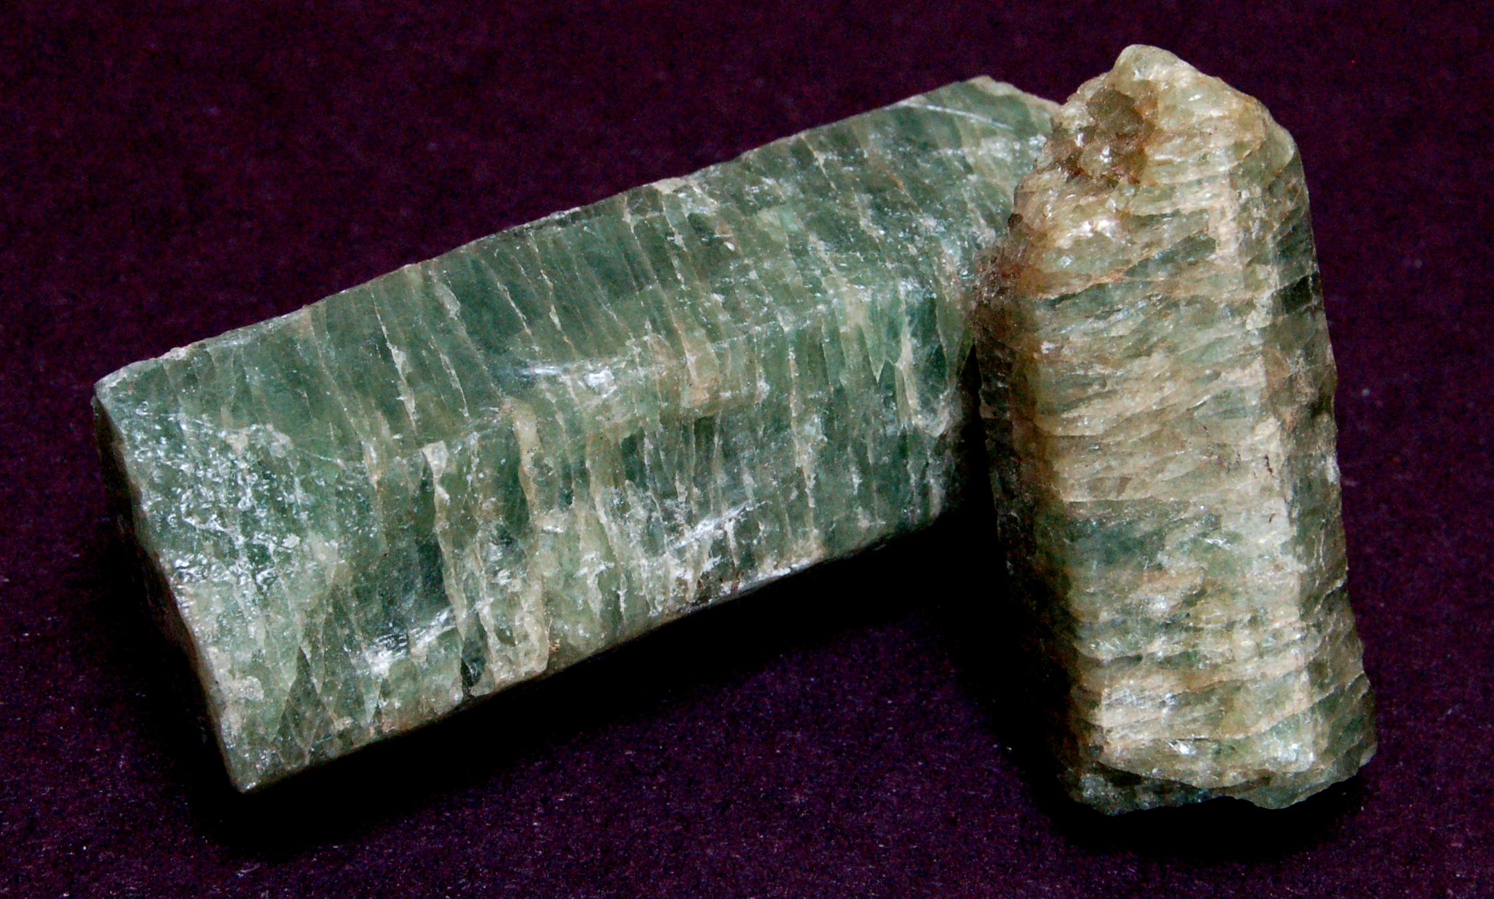
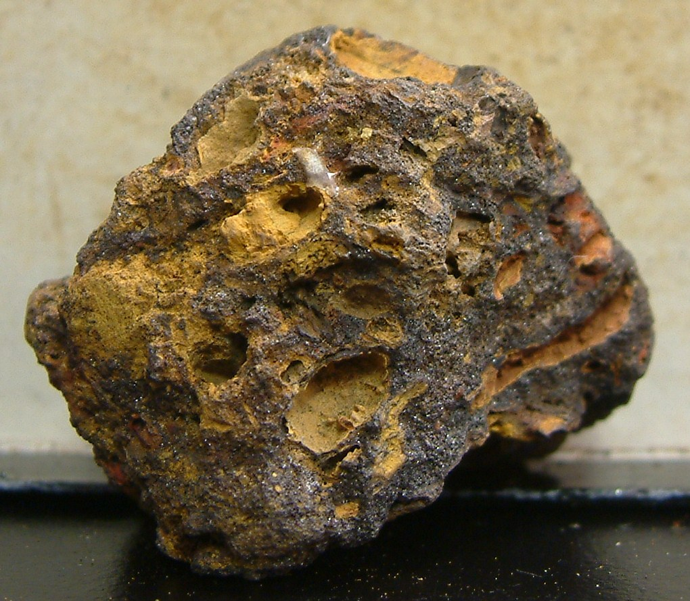
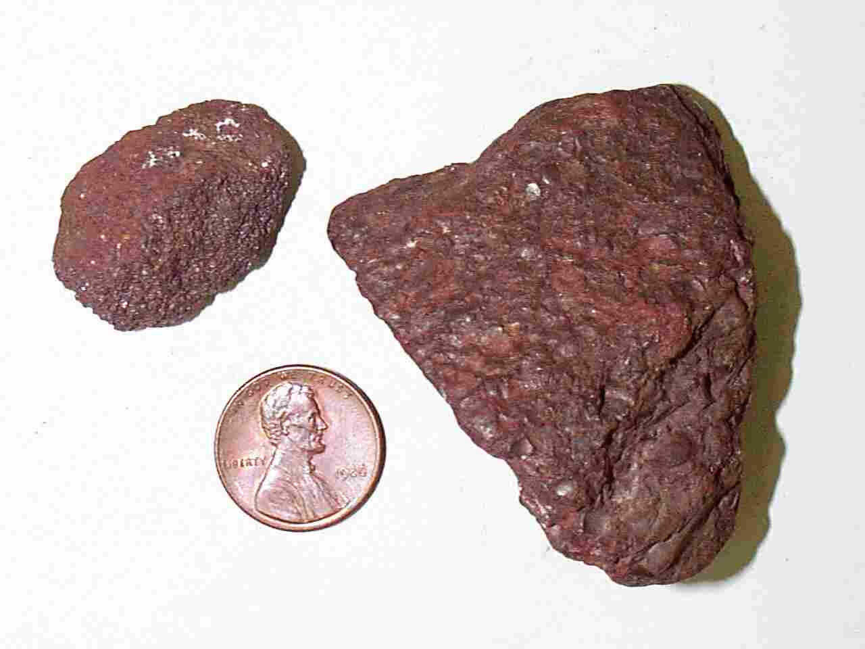
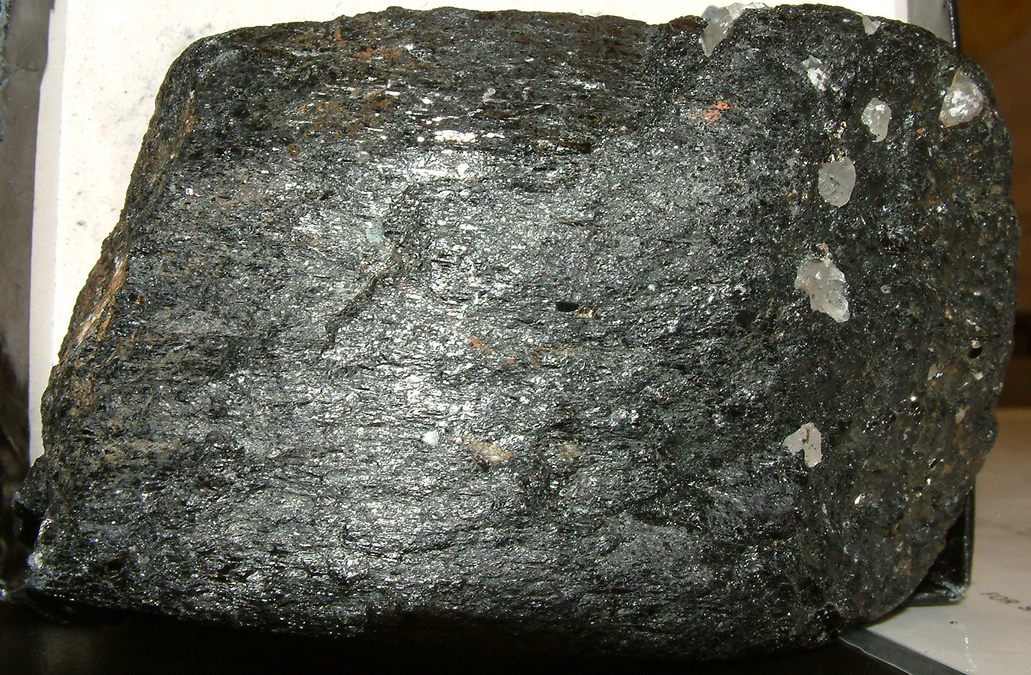
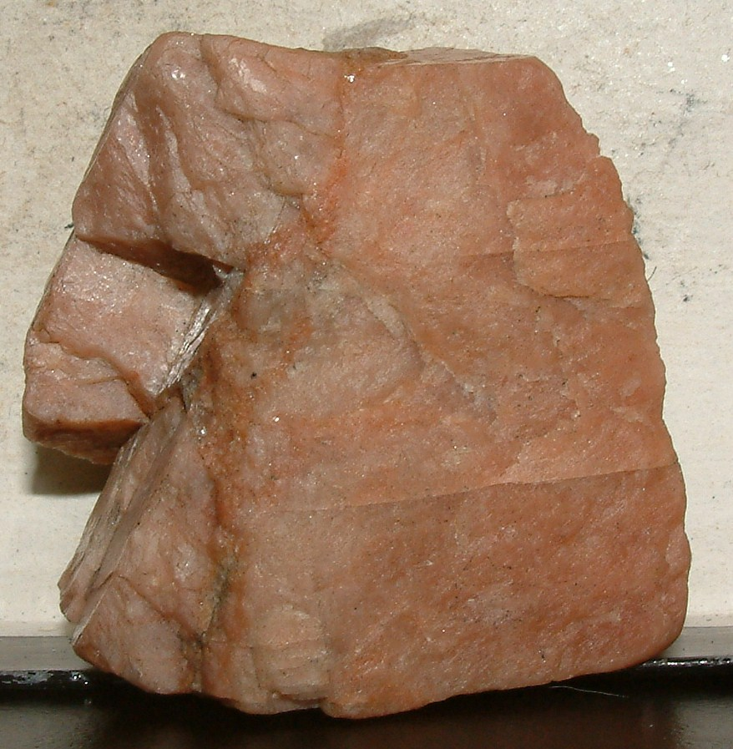
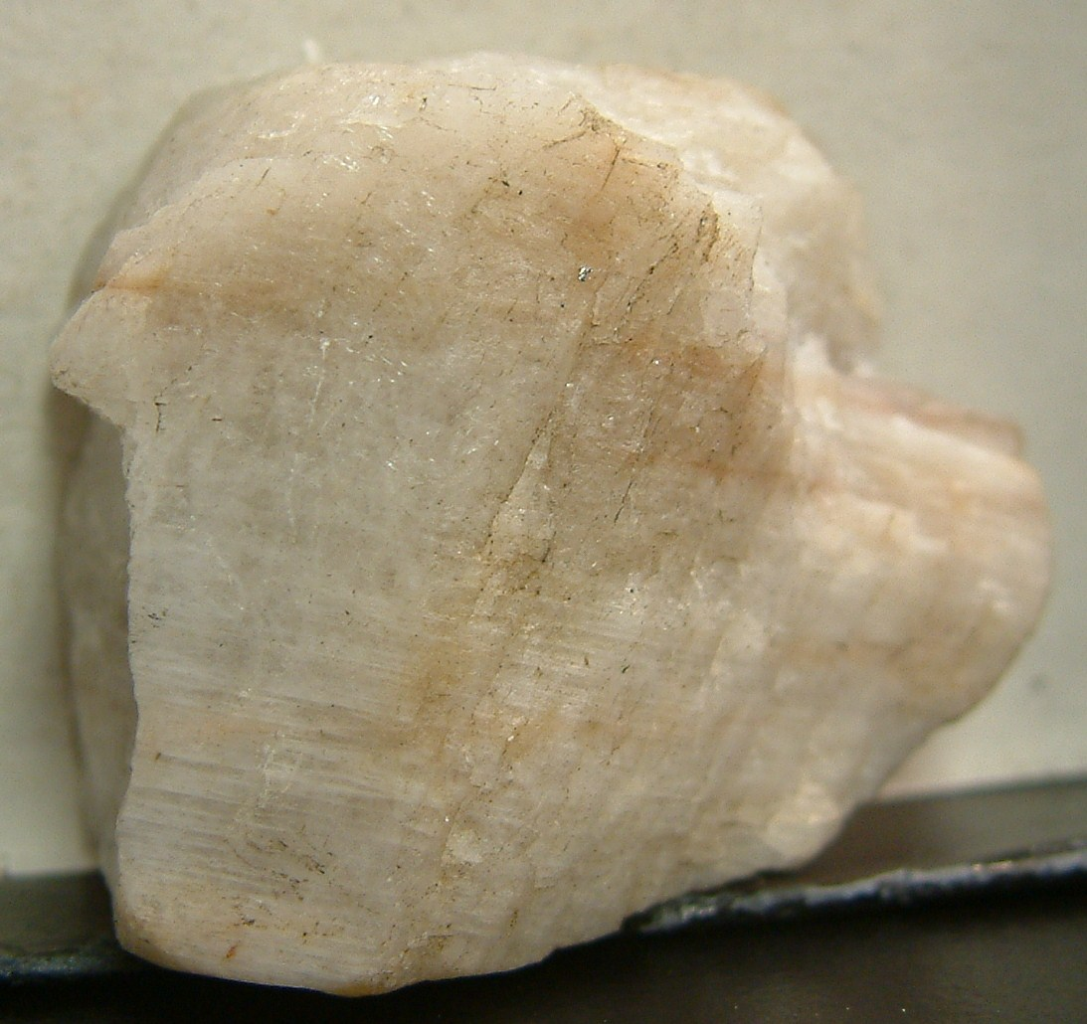
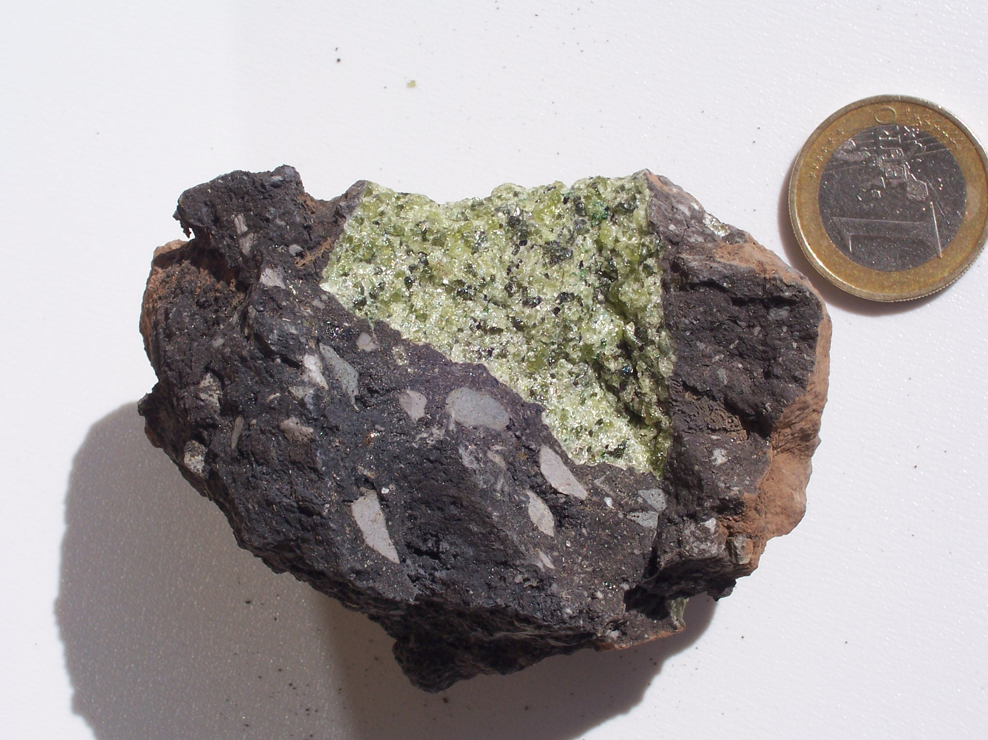
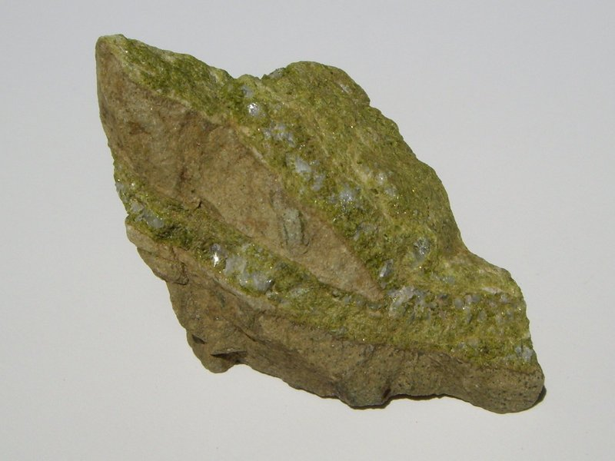
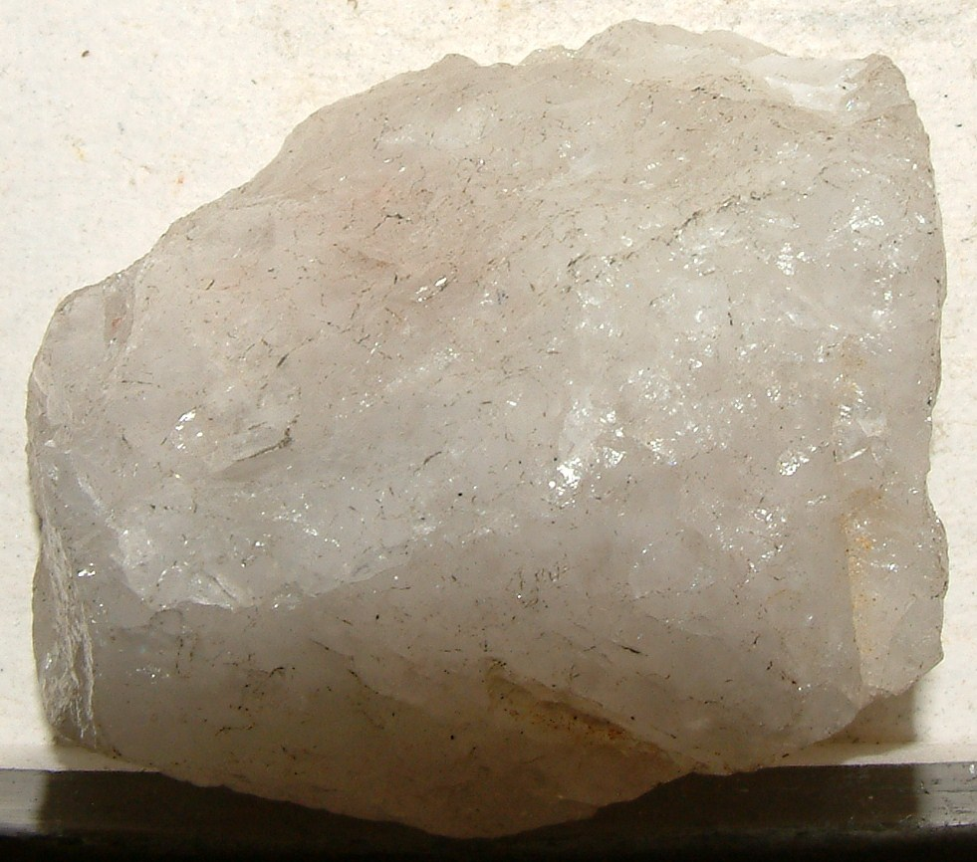
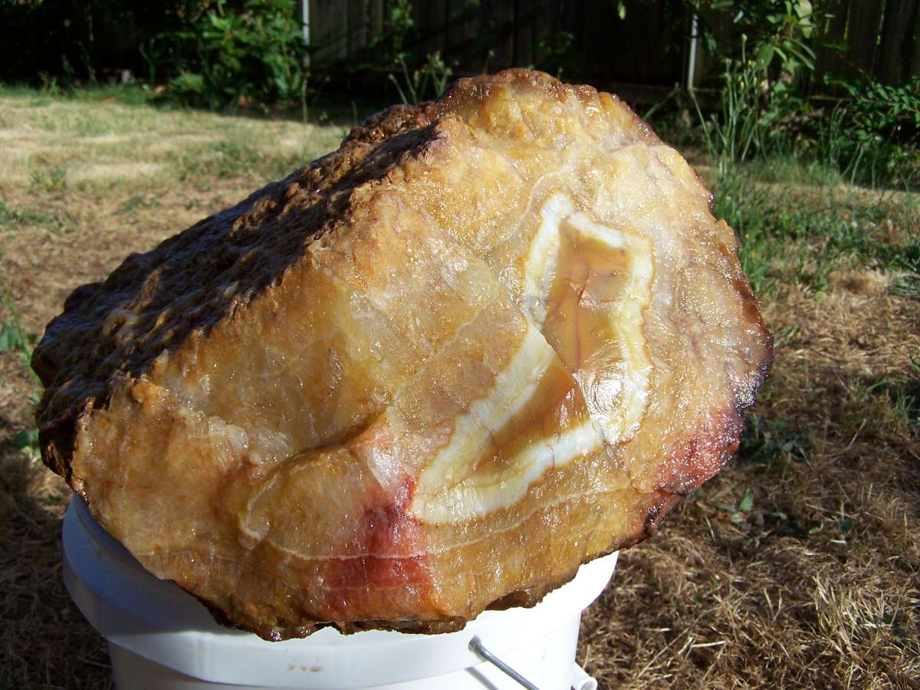
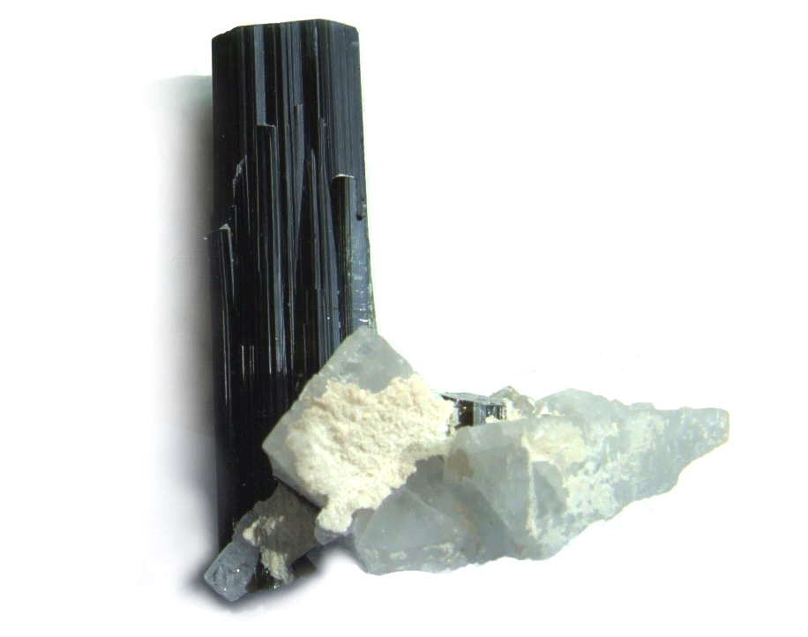
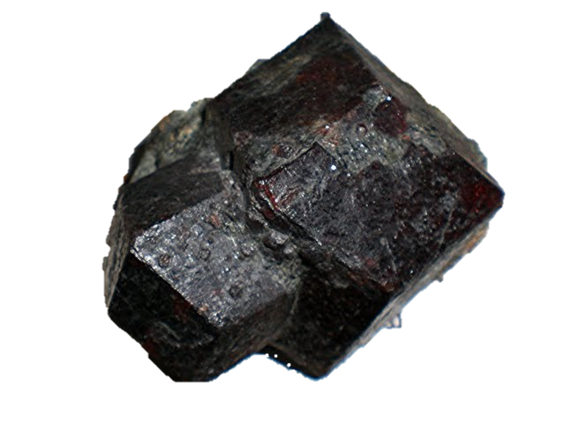
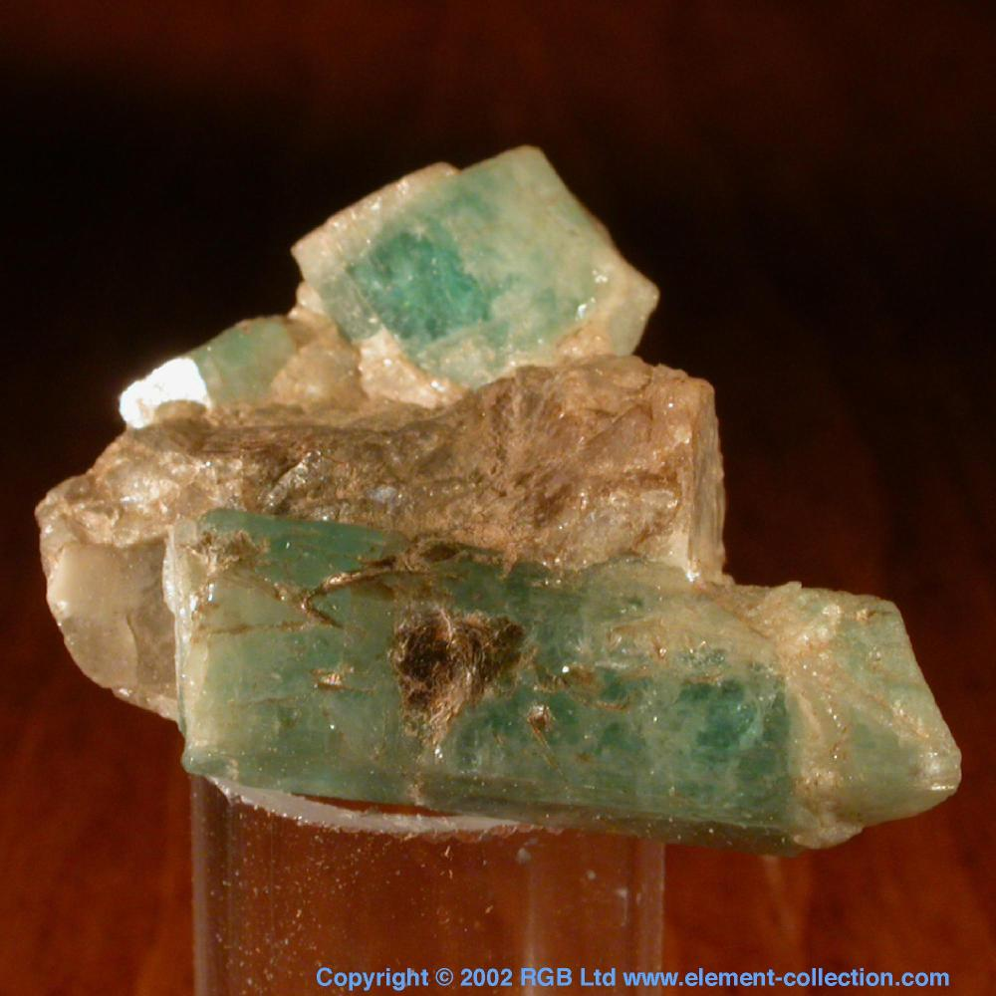
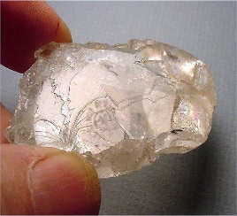
MINERALS

Slide 3
GRAPHITE
Physical Properties of Graphite
Chemical Classification | Native element
Color | Steel gray to black
Streak | Black
Luster | Metallic, sometimes earthy
Diaphaneity | Opaque
Cleavage | Perfect in one direction
Mohs Hardness | 1 to 2
Specific Gravity | 2.1 to 2.3
Diagnostic Properties | Color, streak, slippery feel, specific gravity
Chemical Composition | C
Crystal System | Hexagonal
Uses | Used to manufacture heat and chemical resistant containers and other objects. Battery anodes. A dry lubricant. The "lead" in pencils.

Slide 4
GALENA
Physical Properties of Galena
Chemical Classification | Sulfide
Color | Fresh surfaces are bright silver in color with a bright metallic luster, tarnishes to a dull lead gray
Streak | Lead gray to black
Luster | Metallic on fresh surfaces, tarnishes dull
Diaphaneity | Opaque
Cleavage | Perfect, cubic, three directions at right angles
Mohs Hardness | 2.5+
Specific Gravity | 7.4 to 7.6
Diagnostic Properties | Color, luster, specific gravity, streak, cleavage, cubic or octahedral crystals.
Chemical Composition | Lead sulfide, PbS
Crystal System | Isometric
Uses | An ore of lead

Slide 5
CHALOPYRITE
Physical Properties of Chalcopyrite
Chemical Classification | Sulfide
Color | Brass yellow. Tarnishes to gray green, sometimes iridescent.
Streak | Greenish black
Luster | Metallic
Diaphaneity | Opaque
Cleavage | Poor
Mohs Hardness | 3.5 to 4
Specific Gravity | 4.1 to 4.3
Diagnostic Properties | Color, greenish streak, softer than pyrite, brittle.
Chemical Composition | Copper iron sulfide, CuFeS₂.
Crystal System | Tetragonal
Uses | The most important ore of copper for thousands of years.

Slide 6
PYRITE
Physical Properties of Pyrite
Chemical Classification | Sulfide
Color | Brass yellow - often tarnished to dull brass
Streak | Greenish black to brownish black
Luster | Metallic
Diaphaneity | Opaque
Cleavage | Breaks with a conchoidal fracture
Mohs Hardness | 6 to 6.5
Specific Gravity | 4.9 to 5.2
Diagnostic Properties | Color, hardness, brittle, greenish black streak, specific gravity
Chemical Composition | Iron sulfide, FeS₂
Crystal System | Isometric
Uses | Ore of gold

Slide 7
MAGNETITE
Physical Properties of Magnetite
Chemical Classification | Oxide
Color | Black to silvery gray
Streak | Black
Luster | Metallic to submetallic
Diaphaneity | Opaque
Cleavage | None
Mohs Hardness | 5 to 6.5
Specific Gravity | 5.2
Diagnostic Properties | Strongly magnetic, color, streak, octahedral crystal form.
Chemical Composition | Fe₃O₄
Crystal System | Isometric
Uses | The most important ore of iron. Heavy media separation. Studies of Earth's magnetic field

Slide 8
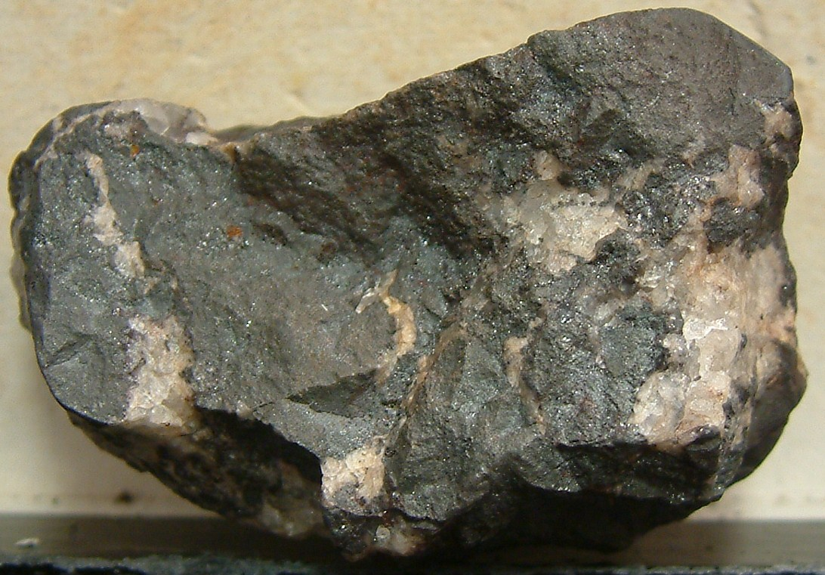
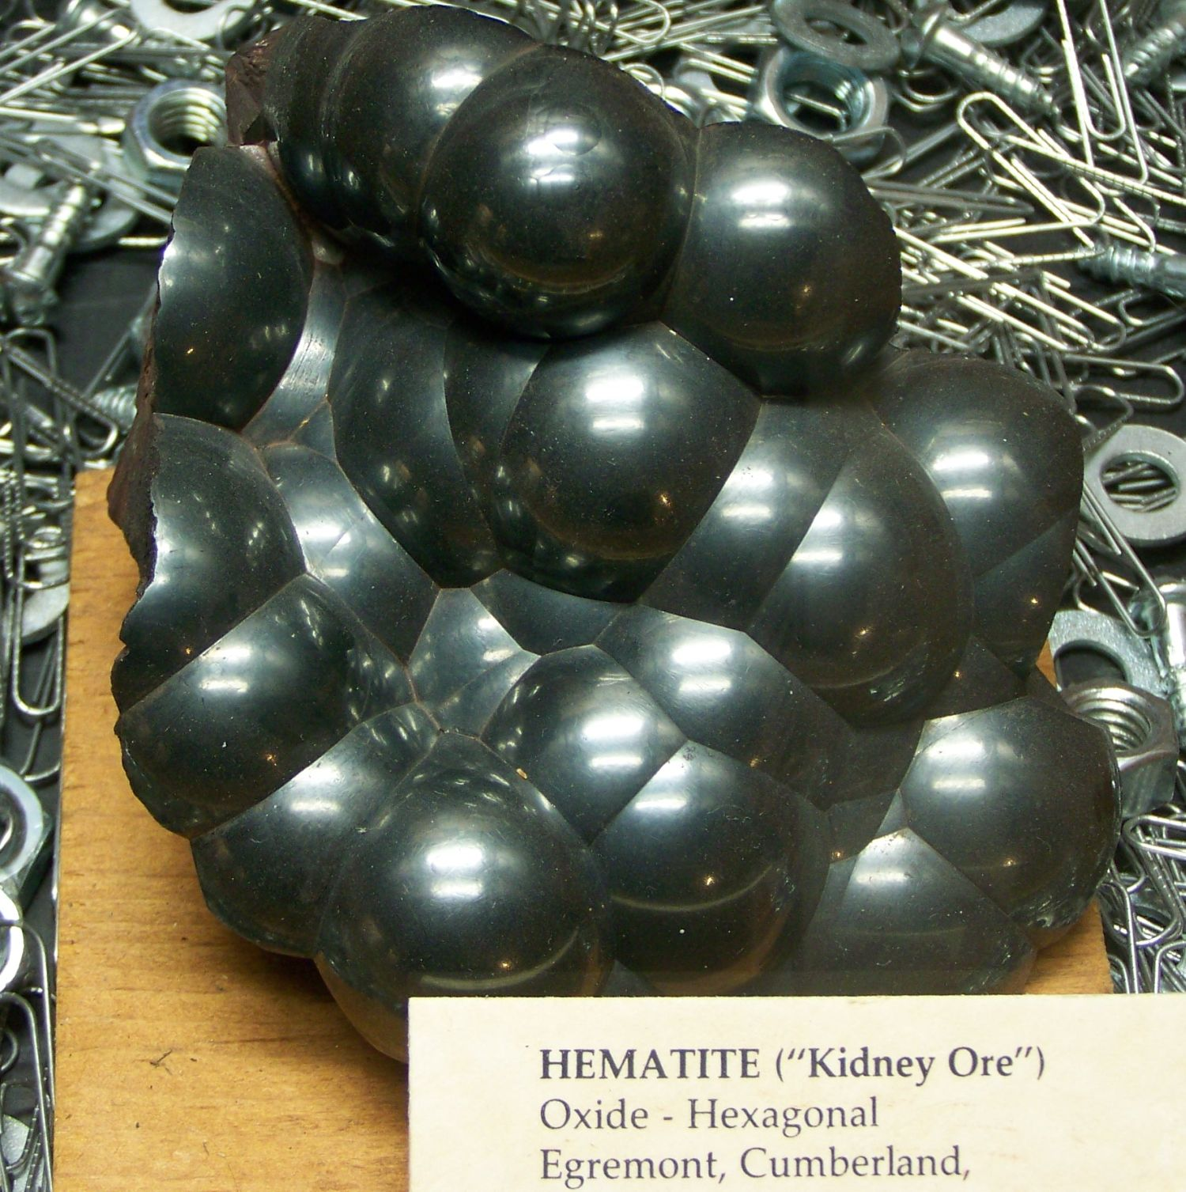
HEMATITE
Physical Properties of Hematite
Chemical Classification | Oxide
Color | Black to steel-gray to silver; red to reddish brown to black
Streak | Red to reddish brown
Luster | Metallic, submetallic, earthy
Diaphaneity | Opaque
Cleavage | None
Mohs Hardness | 5 to 6.5
Specific Gravity | 5.0 to 5.3
Diagnostic Properties | Red streak, specific gravity
Chemical Composition | Fe₂O₃
Crystal System | Trigonal
Uses | The most important ore of iron. Pigment, heavy media separation, radiation shielding, ballast, polishing compounds, a minor gemstone
(SPECULAR)
(MORE FINELY
CRYSTALINE)
(“KIDNEY ORE”)

Slide 9
TALC
Physical Properties of Talc
Chemical Classification | Silicate
Color | Green, white, gray, brown, colorless
Streak | White to pale green
Luster | Pearly
Diaphaneity | Translucent
Cleavage | Perfect
Mohs Hardness | 1
Specific Gravity | 2.7 to 2.8
Diagnostic Properties | Feel, color, softness, cleavage
Chemical Composition | Mg₃Si₄O₁₀(OH)₂
Crystal System | Monoclinic
Uses | Used as a filler and anti-stick coating in plastics, ceramics, paint, paper, roofing, rubber, cosmetics

Slide 10
KAOLINITE
Physical Properties of Talc
Chemical Classification | Silicate
Color | White, sometimes red, blue or brown tints from impurities
Streak | White
Luster | Pearly to dull earthy
Cleavage | Perfect on {001}
Mohs Hardness | 2–2.5
Specific Gravity | 2.16–2.68
Diagnostic Properties | Feel, color, softness, cleavage
Chemical Composition | Al₂Si₂O₅(OH)₄
Crystal System | Triclinic
Uses | The main use of the mineral kaolinite (about 50% of the time) is the production of paper; its use ensures the gloss on some grades of coated paper.

Slide 11
SULFUR
Physical Properties of Sulfur
Chemical Classification | Native element
Color | Yellow. Brownish yellow to greenish yellow. Red when molten at over 200 degrees Celsius. Burns with a flame that can be difficult to see in daylight but is blue in the dark.
Streak | Yellow
Luster | Crystals are resinous to greasy. Powdered sulfur is dull or earthy.
Diaphaneity | Transparent to translucent
Cleavage | None
Mohs Hardness | 1.5 to 2.5
Specific Gravity | 2.0 to 2.1
Diagnostic Properties | Yellow color, low hardness, low specific gravity, extremely flammable burning with a blue flame, low melting temperature
Chemical Composition | S
Crystal System | Orthorhombic
Uses | About 90% is used to manufacture sulfuric acid. The remainder is used in a variety of products that include hydrogen sulfide, insecticides, herbicides, fungicides, pharmaceuticals, soaps, textiles, papers, processed rubber, gunpowder, leather, paint, dyes, food preservatives.

Slide 12
GYPSUM
Physical Properties of Gypsum
Chemical Classification | Sulfate
Color | Clear, colorless, white, gray, yellow, red, brown
Streak | White
Luster | Vitreous, silky, sugary
Diaphaneity | Transparent to translucent
Cleavage | Perfect
Mohs Hardness | 2
Specific Gravity | 2.3
Diagnostic Properties | Cleavage, specific gravity, low hardness
Chemical Composition | Hydrous calcium sulfate, CaSO₄.2H₂O
Crystal System | Monoclinic
Uses | Used to manufacture dry wall, plaster, joint compound. An agricultural soil treatment.

Slide 13
BARITE
Physical Properties of Barite
Chemical Classification | Sulfate
Color | Colorless, white, light blue, light yellow, light red, light green
Streak | White
Luster | Vitreous to pearly
Diaphaneity | Transparent to translucent
Cleavage | Very good, basal, prismatic
Mohs Hardness | 2.5 to 3.5
Specific Gravity | 4.5
Diagnostic Properties | High specific gravity, three cleavage directions at right angles
Chemical Composition | Barium sulfate, BaSO₄
Crystal System | Orthorhombic
Uses | Drilling mud; high-density filler for paper, rubber, plastics

Slide 14
CHLORITE
Physical Properties of Chlorite
Chemical Classification | Silicate
Color | Various shades of green. Rarely yellow, white, pink, black
Streak | Greenish to greenish gray
Luster | Vitreous, pearly, dull
Diaphaneity | Transparent, translucent, opaque
Cleavage | Perfect in one direction
Mohs Hardness | 2 to 3
Specific Gravity | 2.6 to 3.3
Diagnostic Properties | Color, hardness, foliated appearance, feels slightly greasy
Chemical Composition | A generalized formula: (X,Y)₄₋₆(Si,Al)₄O₁₀(OH,O)₈ The "X" and "Y" in the formula represent ions, which might include: Fe⁺², Fe⁺³, Mg⁺², Mn⁺², Ni⁺², Zn⁺², Al⁺³, Li⁺¹, or Ti⁺⁴. The composition and physical properties of chlorites vary as these ions substitute for one another in solid solution.
Crystal System | Monoclinic
Uses | Very few industrial uses. Used as a filler and as a constituent of clay.

Slide 15
MUSCOVITE
Physical Properties of Muscovite
Chemical Classification | Silicate
Color | Thick specimens often appear to be black, brown, or silver in color; however, when split into thin sheets muscovite is colorless, sometimes with a tint of brown, yellow, green, or rose
Streak | White, often sheds tiny flakes
Luster | Pearly to vitreous
Diaphaneity | Transparent to translucent
Cleavage | Perfect
Mohs Hardness | 2.5 to 3
Specific Gravity | 2.8 to 2.9
Diagnostic Properties | Cleavage, color, transparency
Chemical Composition | KAl₂(Si₃AlO₁₀)(OH)₂
Crystal System | Monoclinic
Uses | Used in the manufacturing of paint, joint compound, plastics rubber, asphalt roofing, cosmetics, drilling mud.

Slide 16
BIOTITE
Physical Properties of Biotite
Chemical Classification | Dark mica
Color | Black, dark green, dark brown
Streak | White to gray, flakes often produced
Luster | Vitreous
Diaphaneity | Thin sheets are transparent to translucent, books are opaque.
Cleavage | Basal, perfect
Mohs Hardness | 2.5 to 3
Specific Gravity | 2.7 to 3.4
Diagnostic Properties | Dark color, perfect cleavage
Chemical Composition | K(Mg,Fe)₂₋₃Al₁₋₂Si₂₋₃O₁₀(OH,F)₂
Crystal System | Monoclinic
Uses | Very little industrial use

Slide 17
LEPIDOLITE
Physical Properties of Biotite
Color | Pink, light purple, light rose red, other colors possible but are rare.
Streak | White
Luster | Sub-Vitreous, Resinous, Greasy, Pearly
Diaphaneity | Transparent, Translucent
Cleavage | Perfect {001} perfect
Mohs Hardness | 2½ - 3½
Specific Gravity | 2.8 - 2.9
Chemical Composition | KLi₂Al(Si₄O₁₀)(F,OH)₂ to K(Li_{1.5}Al_{1.5})(AlSi₃O₁₀)(F,OH)₂
Crystal System | Monoclinic

Slide 18
HALITE
Physical Properties of Halite
Chemical Classification | Halide
Color | Colorless or white when pure; impurities produce any color but usually yellow, gray, black, brown, red
Streak | White
Luster | Vitreous
Diaphaneity | Transparent to translucent
Cleavage | Perfect, cubic, three directions at right angles
Mohs Hardness | 2.5
Specific Gravity | 2
Diagnostic Properties | Cleavage, solubility, salty taste (The taste test is discouraged. Some minerals are toxic or contaminated by other people tasting them.)
Chemical Composition | NaCl
Crystal System | Isometric
Uses | Winter road treatment, a source of sodium and chlorine for chemical processes, food preservation, seasoning

Slide 19
CALCITE
Physical Properties of Calcite
Chemical Classification | Carbonate
Color | Usually white but also colorless, gray, red, green, blue, yellow, brown, orange
Streak | White
Luster | Vitreous
Diaphaneity | Transparent to translucent
Cleavage | Perfect, rhombohedral, three directions
Mohs Hardness | 3
Specific Gravity | 2.7
Diagnostic Properties | Rhombohedral cleavage, powdered form effervesces weakly in dilute HCl, curved crystal faces and frequent twinning
Chemical Composition | CaCO₃
Crystal System | Hexagonal
Uses | Acid neutralization, a low-hardness abrasive, soil conditioner, heated for the production of lime

Slide 20
DOLOMITE
Physical Properties of Dolomite
Chemical Classification | Carbonate
Color | Colorless, white, pink, green, gray, brown, black
Streak | White
Luster | Vitreous, pearly
Diaphaneity | Transparent to translucent
Cleavage | Perfect, rhombohedral, three directions
Mohs Hardness | 3.5 to 4
Specific Gravity | 2.8 to 2.9
Diagnostic Properties | Rhombohedral cleavage, powdered form effervesces weakly in dilute HCl, hardness
Chemical Composition | CaMg(CO₃)₂
Crystal System | Hexagonal
Uses | Construction aggregate, cement manufacture, dimension stone, calcined to produce lime, sometimes an oil and gas reservoir, a source of magnesia for the chemical industry, agricultural soil treatments, metallurgical flux

Slide 21
SPHALERITE
Physical Properties of Sphalerite
Chemical Classification | Sulfide
Color | Yellow, brown, black, red, green, white, colorless
Streak | White to yellowish brown, often with an odor of sulfur
Luster | Nonmetallic, submetallic, resinous or adamantine
Diaphaneity | Transparent to translucent
Cleavage | Perfect, dodecahedral, in six directions!
Mohs Hardness | 3.5 to 4
Specific Gravity | 3.9 to 4.1
Diagnostic Properties | Luster, cleavage, streak
Chemical Composition | Zinc sulfide with variable amounts of iron, (Zn,Fe)S
Crystal System | Isometric
Uses | The primary ore of zinc. Often mined for minor amounts of indium, cadmium, germanium, or gallium as profitable byproducts. Mineral specimens. Faceted stones for collectors.

Slide 22
AZURITE
Physical Properties of Azurite
Chemical Classification | Carbonate
Color | Deep blue to violet blue; "azure"
Streak | Light blue
Luster | Vitreous, earthy
Diaphaneity | Opaque, translucent, transparent
Cleavage | Two distinct directions, one perfect, one poor
Mohs Hardness | 3.5 to 4
Specific Gravity | 3.7 to 3.9
Diagnostic Properties | Deep blue color, effervescence in dilute HCl, high specific gravity, low hardness.
Chemical Composition | Copper carbonate. Cu₃(CO₃)₂(OH)₂
Crystal System | Monoclinic
Uses | Minor ore of copper, gem material, ornamental stone, pigment.

Slide 23
FLOURITE
Physical Properties of Fluorite
Chemical Classification | Halide
Color | Typically purple, green, and yellow. Also colorless, blue, red, and black.
Streak | White
Luster | Vitreous
Diaphaneity | Transparent to translucent
Cleavage | Four directions of perfect cleavage
Mohs Hardness | 4
Specific Gravity | 3.2
Diagnostic Properties | Cleavage, hardness, specific gravity, color
Chemical Composition | CaF₂
Crystal System | Isometric
Uses | Numerous uses in the metallurgical, ceramics, and chemical industries. A source of fluorine, hydrofluoric acid, metallurgical flux. High-clarity pieces are used to make lenses for microscopes, telescopes, and cameras.

Slide 24
APATITE
Physical Properties of Apatite
Chemical Classification | Phosphate
Color | Green, brown, blue, yellow, violet, pink, colorless. Transparent specimens with excellent clarity and vivid color are used as gemstones.
Streak | White
Luster | Vitreous to subresinous
Diaphaneity | Transparent to translucent
Cleavage | Poor to indistinct
Mohs Hardness | 5
Specific Gravity | 3.1 to 3.3
Diagnostic Properties | Color, crystal form, and hardness. Brittle, often highly fractured. Can be scratched with a steel knife blade.
Chemical Composition | A group of calcium phosphates. Fluorapatite: Ca₅(PO₄)₃F, Hydroxylapatite: Ca₅(PO₄)₃(OH), Chlorapatite: Ca₅(PO₄)₃Cl Carbonate-rich apatite/francolite: Ca₅(PO₄,CO₃)₃(F,O)
Crystal System | Hexagonal
Uses | Fertilizer, phosphoric acid, hydrofluoric acid, gemstones, ore of rare earth elements, pigments, gemstone. Serves as a hardness of 5 on the Mohs Hardness Scale.

Slide 25
LIMONITE
Physical Properties of Limonite
Chemical Classification | Amorphous, mineraloid
Color | Yellowish brown to brown to black
Streak | Yellowish brown
Luster | Dull to earthy
Diaphaneity | Opaque
Cleavage | Does not cleave because it has an amorphous structure.
Mohs Hardness | 1 to 5 (weathered material can be deceptively soft)
Specific Gravity | 2.7 to 4.3 (varies due to impurities)
Diagnostic Properties | Variable - can be yellow-brown, brown, reddish brown
Chemical Composition | A hydrated iron oxide of variable composition
Crystal System | Amorphous to cryptocrystalline
Uses | Ocher pigments, a minor ore of iron

Slide 26
HEMATITE
Physical Properties of Hematite
Chemical Classification | Oxide
Color | Black to steel-gray to silver; red to reddish brown to black
Streak | Red to reddish brown
Luster | Metallic, submetallic, earthy
Diaphaneity | Opaque
Cleavage | None
Mohs Hardness | 5 to 6.5
Specific Gravity | 5.0 to 5.3
Diagnostic Properties | Red streak, specific gravity
Chemical Composition | Fe₂O₃
Crystal System | Trigonal
Uses | The most important ore of iron. Pigment, heavy media separation, radiation shielding, ballast, polishing compounds, a minor gemstone

Slide 27
HONRNBLENDE
Physical Properties of Hornblende
Chemical Classification | Silicate
Color | Usually black, dark green, dark brown
Streak | White, colorless - (brittle, often leaves cleavage debris behind instead of a streak)
Luster | Vitreous
Diaphaneity | Translucent to nearly opaque
Cleavage | Two directions intersecting at 124 and 56 degrees
Mohs Hardness | 5 to 6
Specific Gravity | 2.9 to 3.5 (varies depending upon composition)
Diagnostic Properties | Cleavage, color, elongate habit
Chemical Composition | (Ca,Na)_{2–3}(Mg,Fe,Al)₅(Al,Si)₈O₂₂(OH,F)₂
Crystal System | Monoclinic
Uses | Very little industrial use

Slide 28
AUGITE
Physical Properties of Augite
Chemical Classification | A single chain inosilicate
Color | Dark green, black, brown
Streak | White to gray to very pale green. Augite is often brittle, breaking into splintery fragments on the streak plate. These can be observed with a hand lens. Rubbing the debris with a finger produces a gritty feel with a fine white powder beneath.
Luster | Vitreous on cleavage and crystal faces. Dull on other surfaces.
Diaphaneity | Usually translucent to opaque. Rarely transparent.
Cleavage | Prismatic in two directions that intersect at slightly less than 90 degrees.
Mohs Hardness | 5.5 to 6
Specific Gravity | 3.2 to 3.6
Diagnostic Properties | Two cleavage directions intersecting at slightly less than 90 degrees. Green to black color. Specific gravity.
Chemical Composition | A complex silicate. (Ca,Na)(Mg,Fe,Al)(Si,Al)₂O₆
Crystal System | Monoclinic
Uses | No significant commercial use.

Slide 29
POTASSIUM FELDSPAR
Physical Properties of Augite
Chemical Classification | A single chain inosilicate
Color | pink, white, gray, brown
Streak | white
Luster | Vitreous
Diaphaneity | opaque
Cleavage | two or three
Mohs Hardness | 6.0–6.5
Specific Gravity | 2.55–2.76
Chemical Composition | KAlSi₃O₈ – NaAlSi₃O₈ – CaAl₂Si₂O₈
Crystal System | Triclinic or monoclinic

Slide 30
PLAGIOCLASE FELDSPAR
Physical Properties of Augite
Chemical Classification | A single chain inosilicate
Color | pink, white, gray, brown
Streak | white
Luster | Vitreous
Diaphaneity | opaque
Cleavage | two or three
Mohs Hardness | 6.0–6.5
Specific Gravity | 2.55–2.76
Chemical Composition | KAlSi₃O₈ – NaAlSi₃O₈ – CaAl₂Si₂O₈
Crystal System | Triclinic or monoclinic

Slide 31
OLIVINE
Physical Properties of Olivine
Chemical Classification | Silicate
Color | Usually olive green, but can be yellow-green to bright green; iron-rich specimens are brownish green to brown
Streak | Colorless
Luster | Vitreous
Diaphaneity | Transparent to translucent
Cleavage | Poor cleavage, brittle with conchoidal fracture
Mohs Hardness | 6.5 to 7
Specific Gravity | 3.2 to 4.4
Diagnostic Properties | Green color, vitreous luster, conchoidal fracture, granular texture
Chemical Composition | Typically (Mg, Fe)₂SiO₄. Ca, Mn, and Ni rarely occupy the Mg and Fe positions.
Crystal System | Orthorhombic
Uses | Gemstones, a declining use in bricks and refractory sand

Slide 32
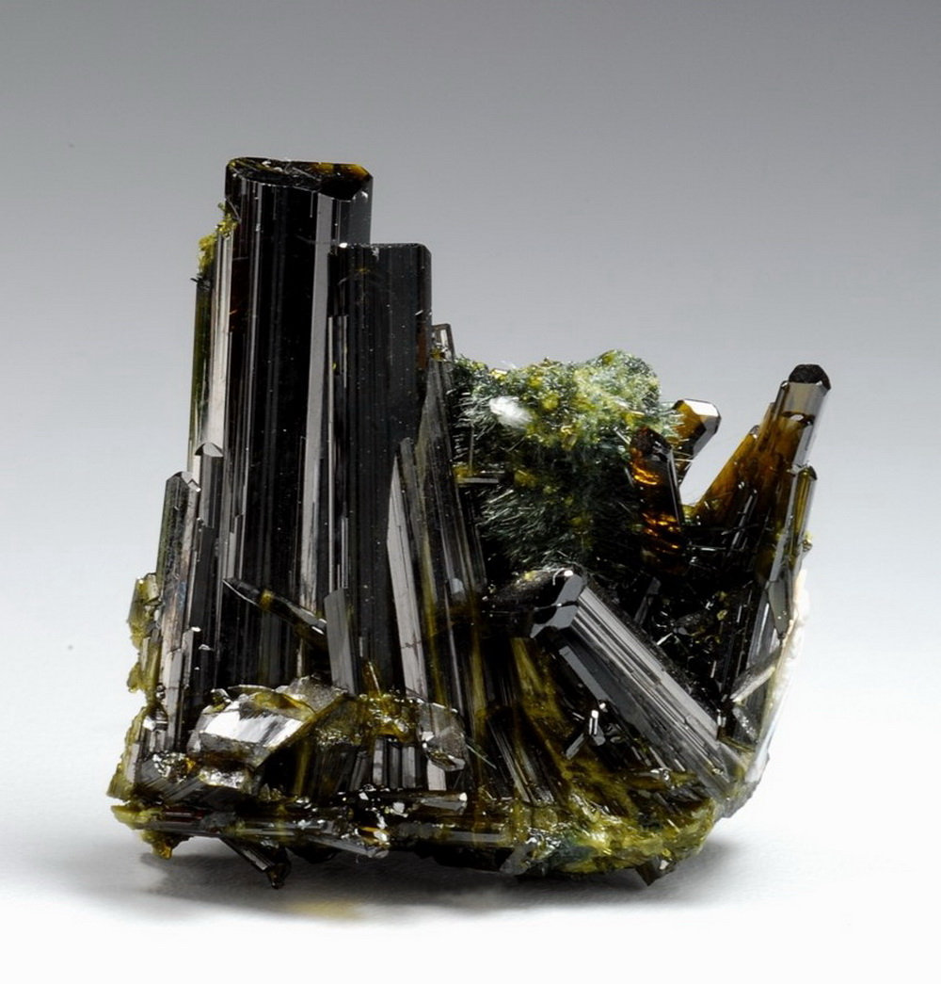
EPIDOTE
Physical Properties of Epidote
Chemical Classification | Silicate
Color | Usually yellowish green to pistachio green, sometimes brownish green to black
Streak | Colorless
Luster | Vitreous to resinous
Diaphaneity | Transparent to translucent to nearly opaque
Cleavage | Perfect in one direction, imperfect
Mohs Hardness | 6 to 7
Specific Gravity | 3.3 to 3.5
Diagnostic Properties | Color, cleavage, specific gravity
Chemical Composition | Ca₂(Al₂,Fe)(SiO₄)(Si₂O₇)O(OH)
Crystal System | Monoclinic
Uses | Semiprecious gem

Slide 33
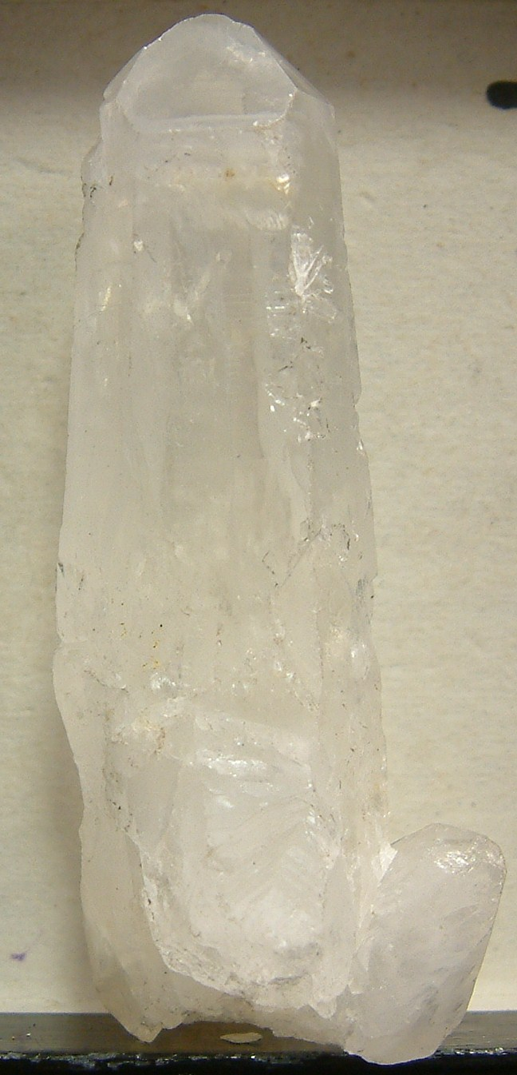
QUARTZ
Physical Properties of Quartz
Chemical Classification | Silicate
Color | Quartz occurs in virtually every color. Common colors are clear, white, gray, purple, yellow, brown, black, pink, green, red.
Streak | Colorless (harder than the streak plate)
Luster | Vitreous
Diaphaneity | Transparent to translucent
Cleavage | None - typically breaks with a conchoidal fracture
Mohs Hardness | 7
Specific Gravity | 2.6 to 2.7
Diagnostic Properties | Conchoidal fracture, glassy luster, hardness
Chemical Composition | SiO₂
Crystal System | Hexagonal
Uses | Glass making, abrasive, foundry sand, hydraulic fracturing proppant, gemstones

Slide 34
CHALCEDONY
Physical Properties of Quartz
Chemical Classification | Silicon dioxide
Color | White, blue, red, green, yellow, orange, brown, pink, purple, gray, black, colorless, and multicolored. Often banded in many different color combinations, and a few rarer forms are iridescent.
Streak | White
Luster | Vitreous, waxy, or dull
Diaphaneity | Transparent to opaque
Cleavage | None
Mohs Hardness | 7
Specific Gravity | 2.6 to 2.7
Diagnostic Properties | Conchoidal fracture, glassy luster, hardness
Chemical Composition | SiO₂
Crystal System | Hexagonal

Slide 35
TOURMALINE
Physical Properties of Tourmaline
Chemical Classification | Boron silicate
Color | Black is the most common color. Also occurs in blue, green, yellow, pink, red, orange, purple, brown, and colorless. Single crystals are often zoned.
Streak | White when softer than the streak plate. Colorless when harder than the streak plate.
Luster | Vitreous
Diaphaneity | Transparent to translucent to nearly opaque
Cleavage | Indistinct
Mohs Hardness | 7 to 7.5
Specific Gravity | 2.8 to 3.3
Diagnostic Properties | Lack of visible cleavage, prismatic crystals with rounded triangular cross-sections that are often striated, vibrant colors, pleochroism.
Chemical Composition | (Ca,Na,K,[vacancy]) (Li,Mg,Fe⁺²,Fe⁺³,Mn⁺²,Al,Cr⁺³,V⁺³)₃(Mg,Al,Fe⁺³,V⁺³,Cr⁺³)₆ ((Si,Al,B)₆O₁₈) (BO₃)₃(OH,O)₃ (OH,F,O)
Crystal System | Hexagonal
Uses | A popular gemstone and mineral specimen

Slide 36
GARNET
Physical Properties of Garnet
Chemical Classification | Silicate
Color | Typically red, but can be orange, green, yellow, purple, black, or brown. Blue garnets are extremely rare.
Streak | Colorless
Luster | Vitreous
Diaphaneity | Transparent to translucent
Cleavage | None
Mohs Hardness | 6.5 to 7.5
Specific Gravity | 3.5 to 4.3
Diagnostic Properties | Hardness, specific gravity, isometric crystal form, lack of cleavage
Chemical Composition | General formula: X₃Y₂(SiO₄)₃
Crystal System | Isometric
Uses | Waterjet cutting granules, abrasive blasting granules, filtration granules, abrasive grits and powders, gemstones

Slide 37
BERYL
Physical Properties of Beryl
Chemical Classification | Silicate
Color | Green, yellow, blue, red, pink, orange, colorless
Streak | Colorless (harder than the streak plate)
Luster | Vitreous
Diaphaneity | Translucent to transparent
Cleavage | Imperfect
Mohs Hardness | 7.5 to 8
Specific Gravity | 2.6 to 2.8
Diagnostic Properties | Crystals are prismatic with flat terminations, hexagonal, and without striations. Hardness and relatively low specific gravity.
Chemical Composition | Be₃Al₂Si₆O₁₈
Crystal System | Hexagonal (occurs in prismatic to tabular crystals)
Uses | Gemstones, a minor ore of beryllium.

Slide 38
TOPAZ
Physical Properties of Topaz
Chemical Classification | Silicate.
Color | Natural colors include: colorless, yellow, orange, brown, red, pink, blue, green. Occurs in a wide range of treated colors, most often blue.
Streak | Colorless - harder than the streak plate.
Luster | Vitreous.
Diaphaneity | Translucent to transparent.
Cleavage | Perfect basal cleavage.
Mohs Hardness | 8
Specific Gravity | 3.4 to 3.6
Diagnostic Properties | Hardness, prismatic crystals, sometimes striated, cleavage, specific gravity.
Chemical Composition | Al₂SiO₄(F,OH)₂
Crystal System | Orthorhombic.
Uses | Gemstone, Mohs hardness index mineral.

